Slide 1



E4S: Extreme-scale Scientific Software Stack
ECP Annual Meeting
Mon, Feb. 6, 2023, 2-3:30pm CT
Prof. Sameer Shende
University of Oregon
ParaTools, Inc.
https://e4s.io/talks/E4S_ECPAM23.pdf

Slide 2
ECP’s holistic approach uses co-design and integration to achieve exascale computing
Performant mission and science applications at scale
Aggressive
RD&D project
Mission apps; integrated S/W stack
Deployment to DOE HPC Facilities
Hardware
technology advances
Application Development (AD)
Software Technology (ST)
Hardware and Integration (HI)
Develop and enhance the predictive capability of applications critical to DOE
24 applications
National security, energy,
Earth systems, economic security, materials, data
6 Co-Design Centers
Machine learning, graph analytics, mesh refinement, PDE discretization, particles, online data analytics
Deliver expanded and vertically integrated software stack to achieve full potential of exascale computing
71 unique software products spanning programming models and run times,
math libraries,
data and visualization
Integrated delivery of ECP products on targeted systems at leading DOE HPC facilities
6 US HPC vendors
focused on exascale node and system design; application integration and software deployment to Facilities

Slide 3
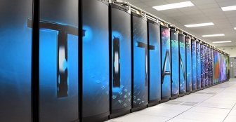
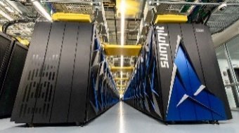

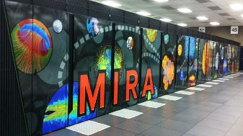
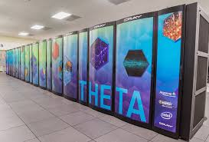

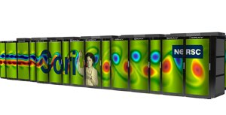
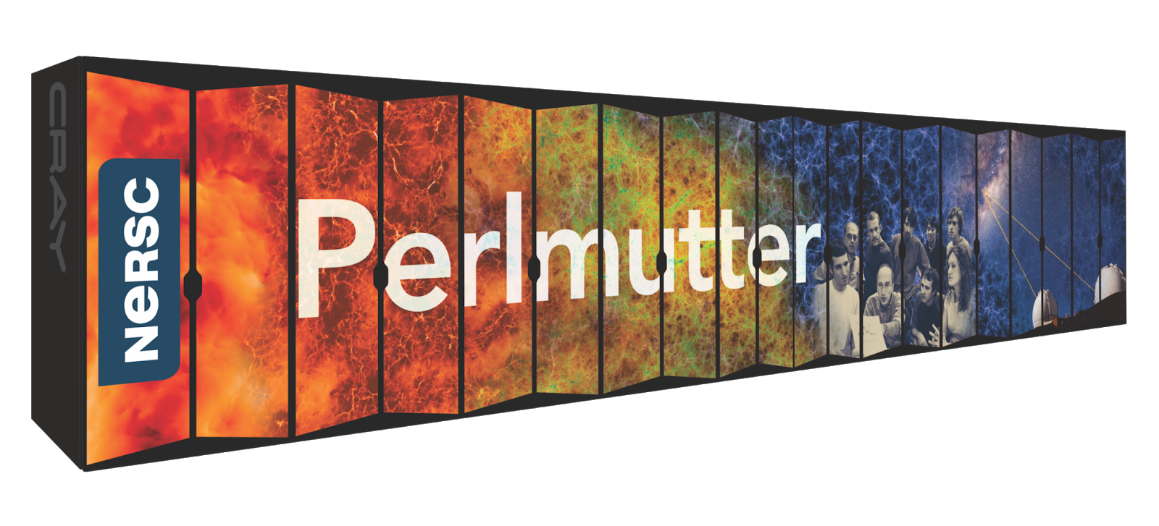
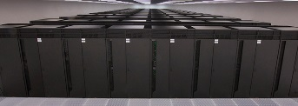
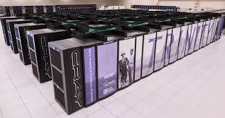
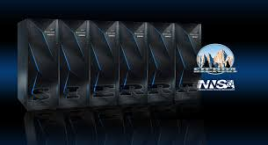


US DOE HPC Roadmap to Exascale Systems
2012-2020
2021-2023
Exascale
Systems
Titan
Summit
ORNL
Cray/AMD/NVIDIA
ORNL
IBM/NVIDIA
ORNL
HPE/AMD
Aurora
Mira
Theta
ANL
Intel/HPE
decommissioned
ANL
IBM BG/Q
ANL
Cray/Intel KNL
Cori
LBNL
Cray/Intel Xeon/KNL
LBNL
HPE/AMD/NVIDIA
Sequoia
LLNL
IBM BG/Q
Trinity
Sierra
LANL/SNL
Cray/Intel Xeon/KNL
LLNL
IBM/NVIDIA
LANL/SNL
HPE/Intel
LLNL
HPE/AMD

Slide 4
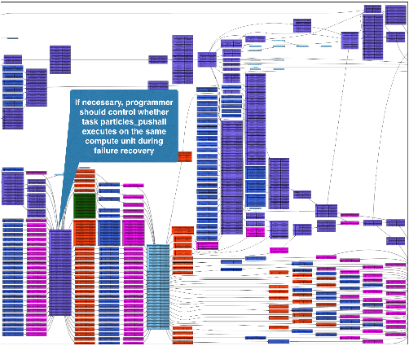
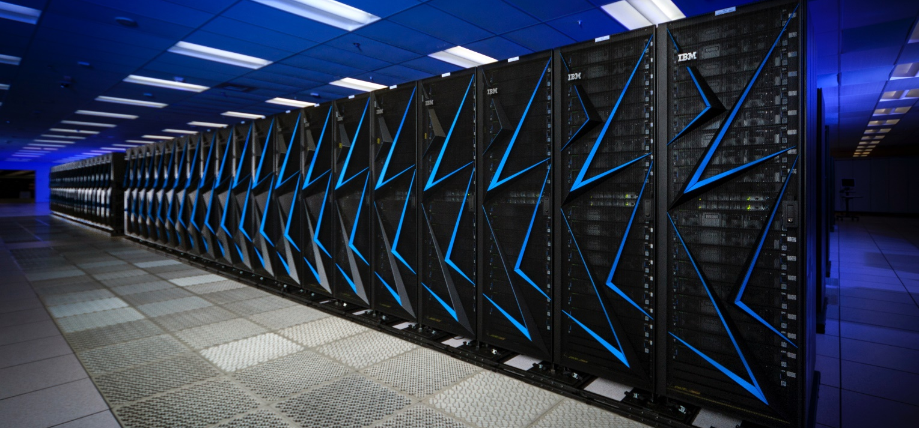
ECP Software Technology (ST)
Goal
Build a comprehensive, coherent software stack that enables application developers to
productively develop highly
parallel applications
that effectively target
diverse exascale
architectures
Prepare SW stack for scalability with massive on-node parallelism
Extend existing capabilities when possible, develop new when not
Guide, and complement, and integrate with vendor efforts
Develop and deliver high-quality and robust software products

Slide 5
Extreme-scale Scientific Software Stack (E4S)

Slide 6
E4S: Better quality, documentation, testing, integration, delivery, building & use
Delivering HPC software to facilities, vendors, agencies, industry, international partners in a brand-new way
DocPortal
Single portal to all E4S product info
Quality Commitment
Community policies, improvement
Build caches
10X build time improvement
Turnkey stack
A new user experience
Quarterly releases Release 22.11 – November
E4S Strategy Group
US agencies, industry, international
https://e4s.io
Portfolio testing
Especially leadership platforms
Curated collection
The end of dependency hell

Slide 7
E4S: Extreme-scale Scientific Software Stack
E4S is a community effort to provide open-source software packages for developing, deploying and running scientific applications on HPC platforms.
E4S has built a comprehensive, coherent software stack that enables application developers to productively develop highly parallel applications that effectively target diverse exascale architectures.
E4S provides a curated, Spack based software distribution of 100+ HPC and AI/ML packages (e.g., TAU, TensorFlow, PyTorch).
With E4S Spack binary build caches, E4S supports both bare-metal and containerized deployment for GPU based platforms.
  X86_64, ppc64le (IBM Power 9), aarch64 (ARM64) with support for GPUs from NVIDIA, AMD, and Intel
  HPC and AI/ML packages are optimized for GPUs and CPUs.
Container images on DockerHub and E4S website of pre-built binaries of ECP ST products.
Base images and full featured containers (with GPU support).
Commercial support for E4S through ParaTools, Inc. for installation, maintaining an issue tracker, and ECP AD engagement.
  https://dashboard.e4s.io https://e4s.io/talks/E4S_Support_Jan23.pdf
E4S for commercial cloud platforms: AWS image supports multiple MPI implementations and containers with remote desktop (DCV).
  Intel MPI, NVHPC, MVAPICH2, MPICH, OpenMPI with Fortran, C, C++ compilers
e4s-cl container launch tool allows binary distribution of applications by substituting MPI in the app with the system MPI.
e4s-alc (coming soon!): à la carte selection of Spack and system packages to build custom, compact container images
Quarterly releases: E4S 22.11 released on November 14, 2022: https://e4s.io/E4S_22.11.pdf
https://e4s.io

Slide 8


Extreme-scale Scientific Software Stack (E4S)
E4S: HPC Software Ecosystem – a curated software portfolio
A Spack-based distribution of software tested for interoperability and portability to multiple architectures with support for GPUs from NVIDIA, AMD, and Intel in a single distribution
Available from source, containers, cloud, binary caches
Leverages and enhances SDK interoperability thrust
Not a commercial product – an open resource for all
Oct 2018: E4S 0.1 - 24 full, 24 partial release products
Jan 2019: E4S 0.2 - 37 full, 10 partial release products
Nov 2019: E4S 1.0 - 50 full, 5 partial release products
Feb 2020: E4S 1.1 - 61 full release products
Nov 2020: E4S 1.2 (aka, 20.10) - 67 full release products
Feb 2021: E4S 21.02 - 67 full release, 4 partial release
May 2021: E4S 21.05 - 76 full release products
Aug 2021: E4S 21.08 - 88 full release products
Nov 2021: E4S 21.11 - 91 full release products
Feb 2022: E4S 22.02 – 100 full release products
May 2022: E4S 22.05 – 101 full release products
August 2022: E4S 22.08 – 102 full release products
November 2022: E4S 22.11 – 103 full release products
https://e4s.io
Also include other products .e.g.,
AI: PyTorch, TensorFlow (CUDA, ROCm)
Co-Design: AMReX, Cabana, MFEM

Slide 9
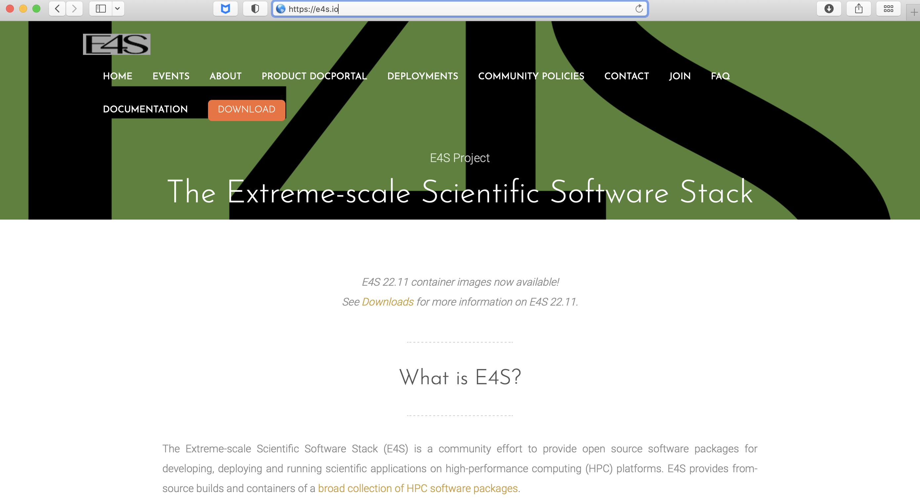
E4S Download from https://e4s.io

Slide 10
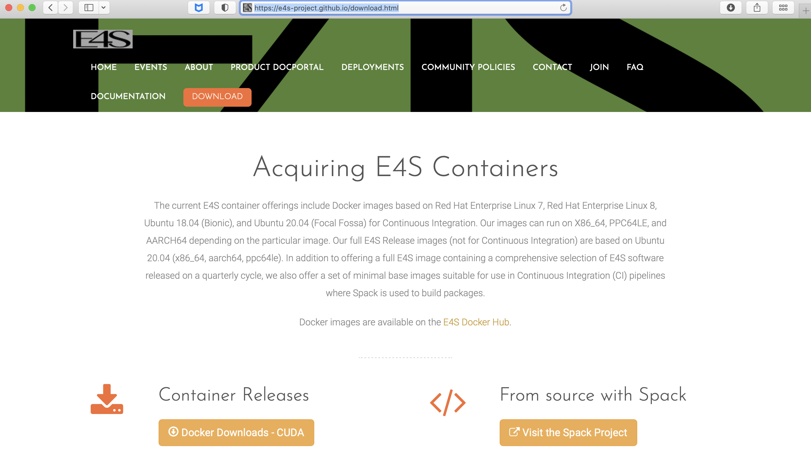
E4S Download from https://e4s.io

Slide 11
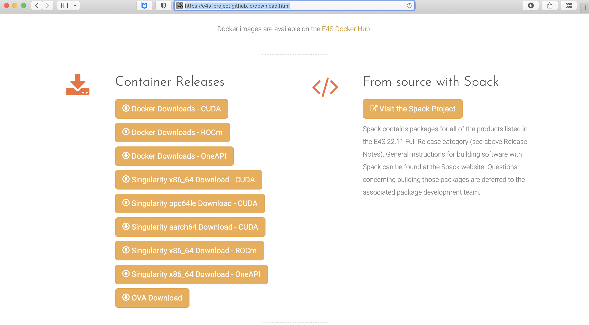
Download E4S 22.11 GPU Container Images: NVIDIA, AMD, Intel
Separate full featured Singularity images for 3 GPU architectures
GPU full featured images for
  x86_64 (Intel, AMD, NVIDIA)
  ppc64le (NVIDIA)
  aarch64 (NVIDIA) NEW!
Full featured images available
on Dockerhub
100+ products on 3 architectures
https://e4s.io
Notes:
quick run through - what ECP ST is working on

Slide 12
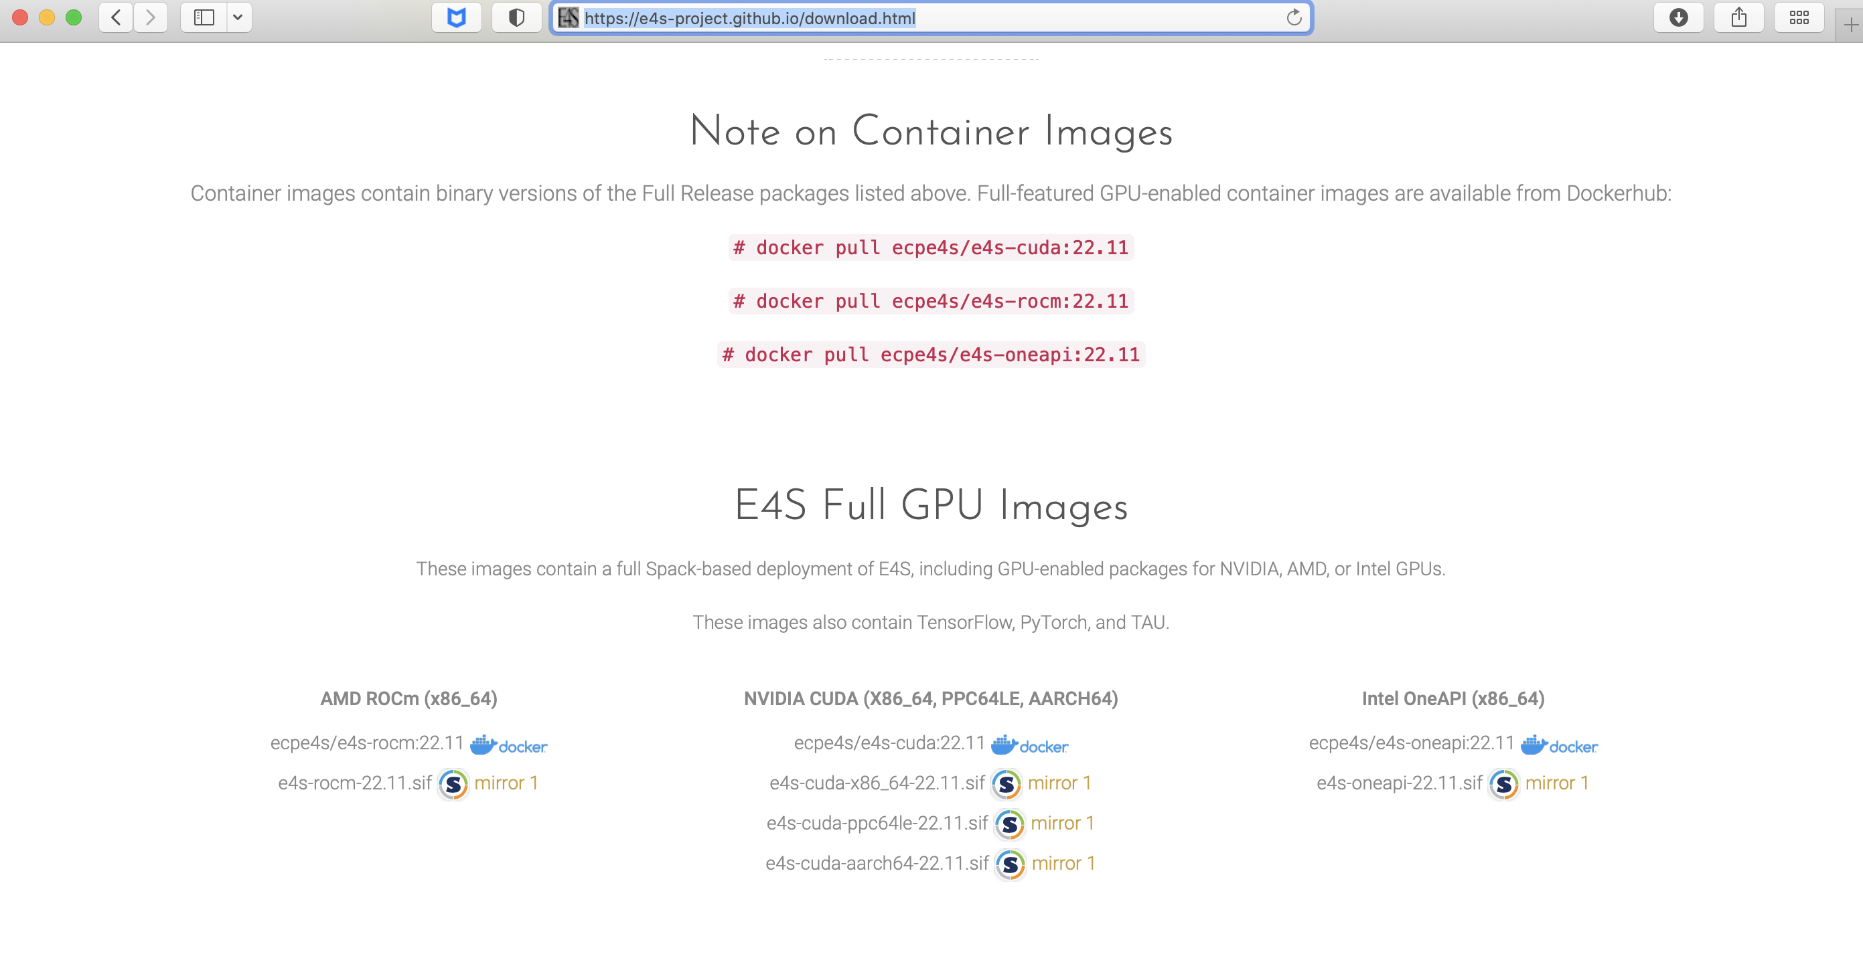
Download E4S 22.11 GPU Container Images: NVIDIA, AMD, Intel
https://e4s.io
Notes:
quick run through - what ECP ST is working on

Slide 13
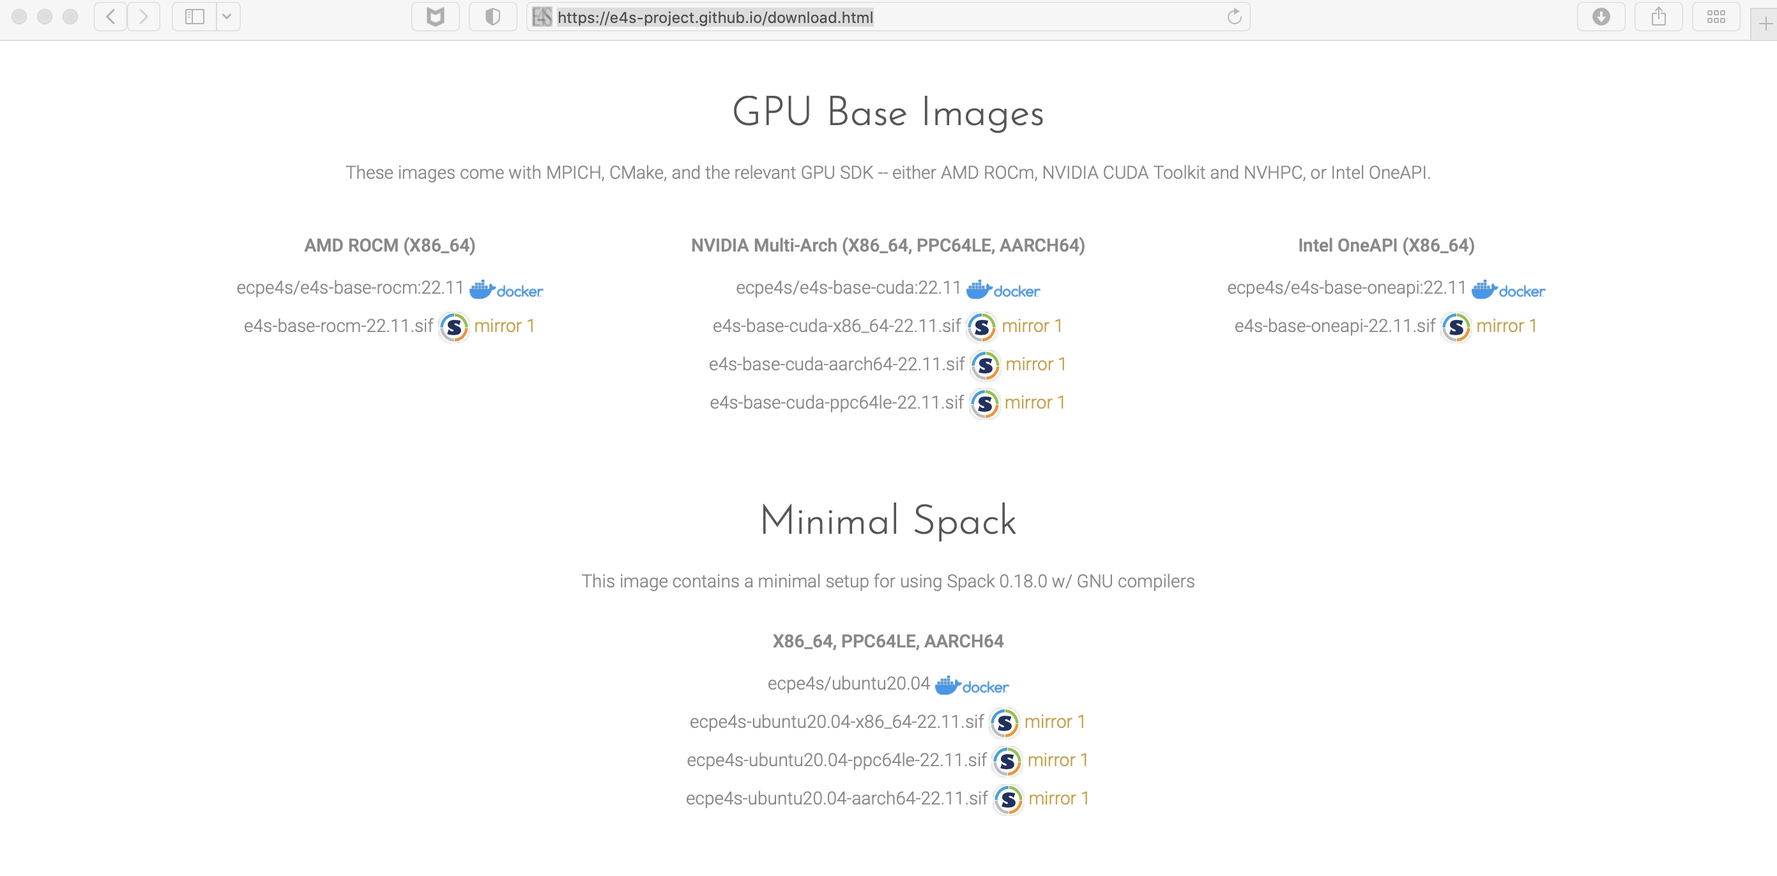
E4S 22.11 Base images and Minimal Spack images with MPI
https://e4s.io
Notes:
quick run through - what ECP ST is working on

Slide 14
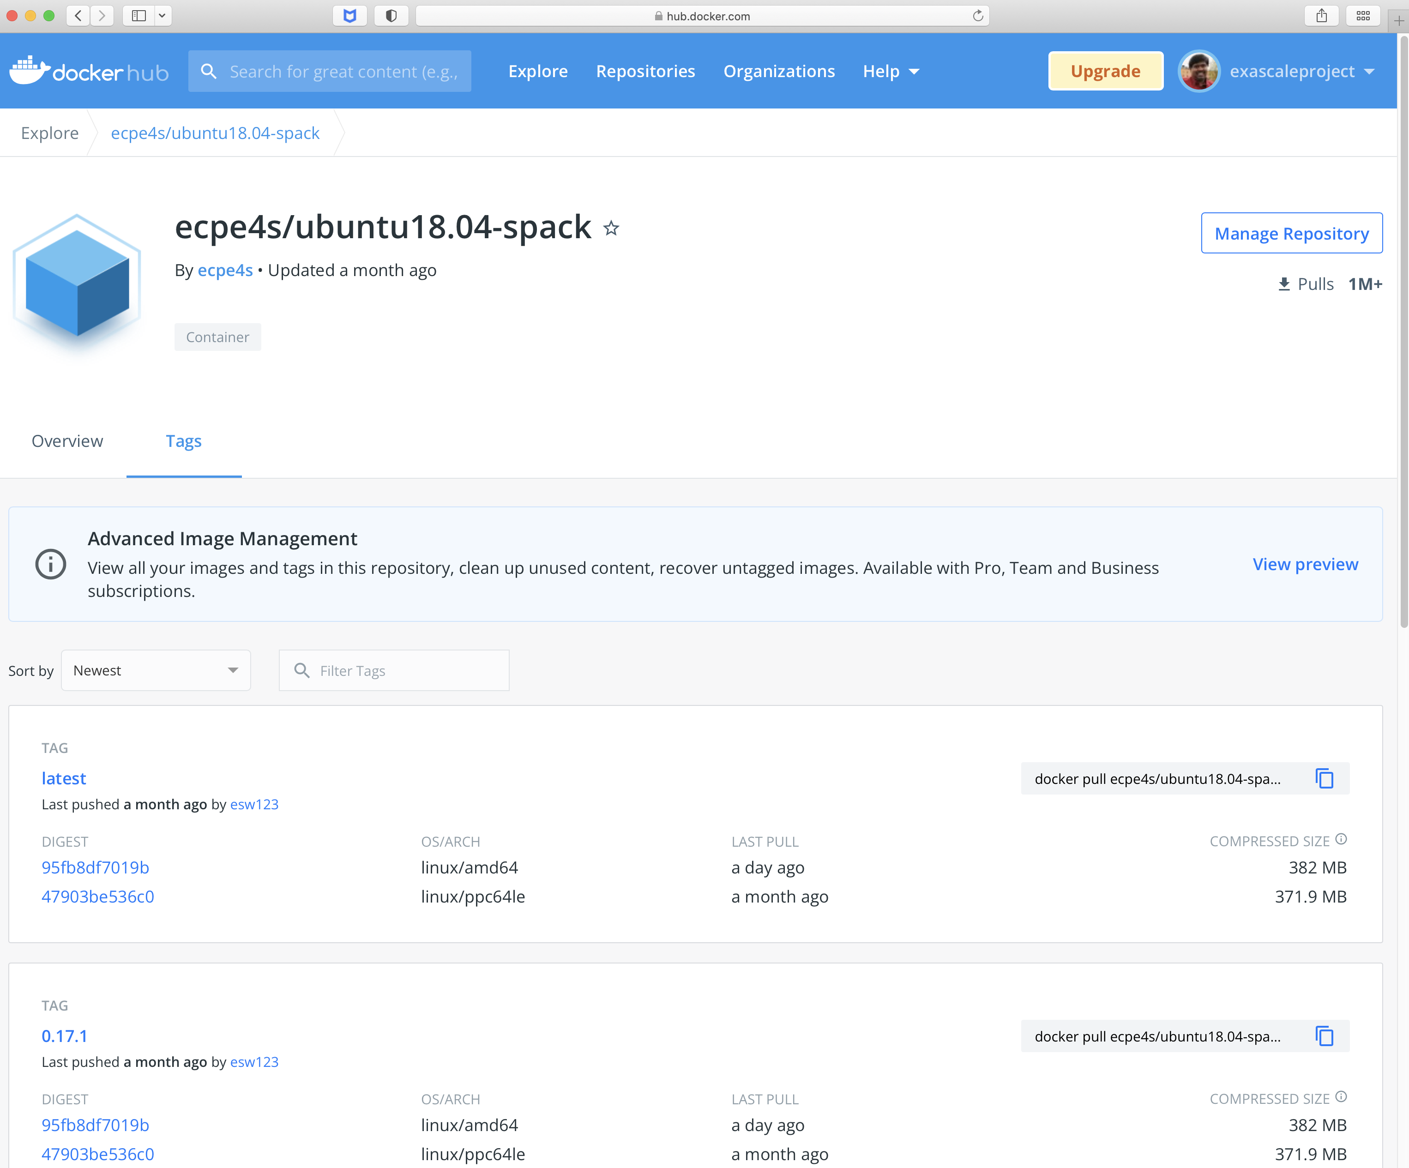
Minimal Spack base image on Dockerhub
Create custom
container images
1M+ downloads!

Slide 15
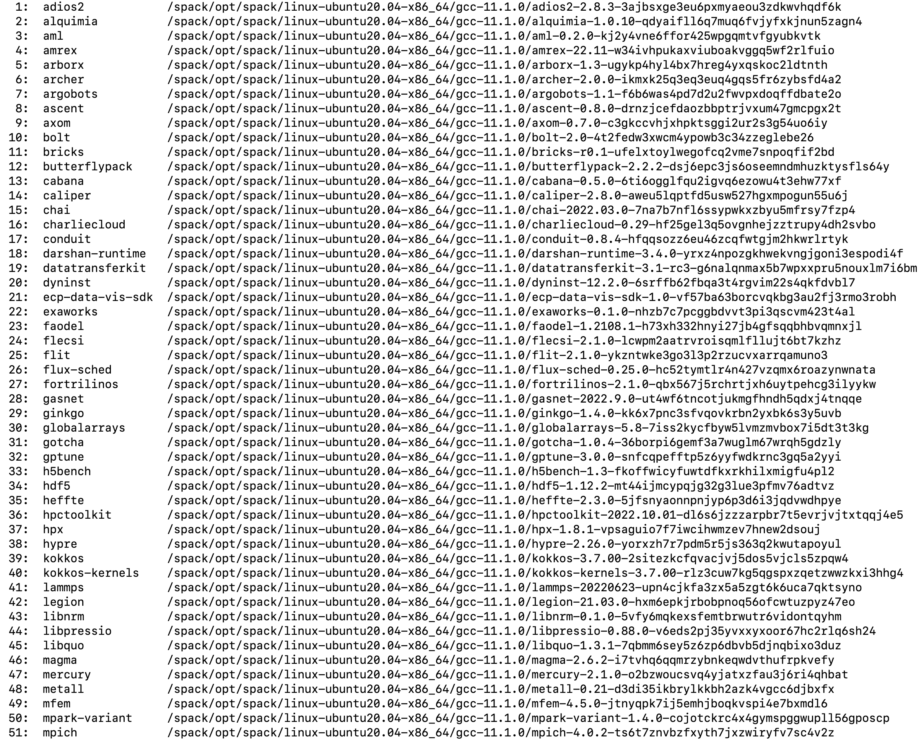
22.11 Release: 100+ Official Products + dependencies (gcc, x86_64)
GPU runtimes
AMD (ROCm)
  5.2.0
Intel (oneAPI)
  2022.1.0
NVIDIA (CUDA)
  11.4.2
NVHPC
  22.9

Slide 16
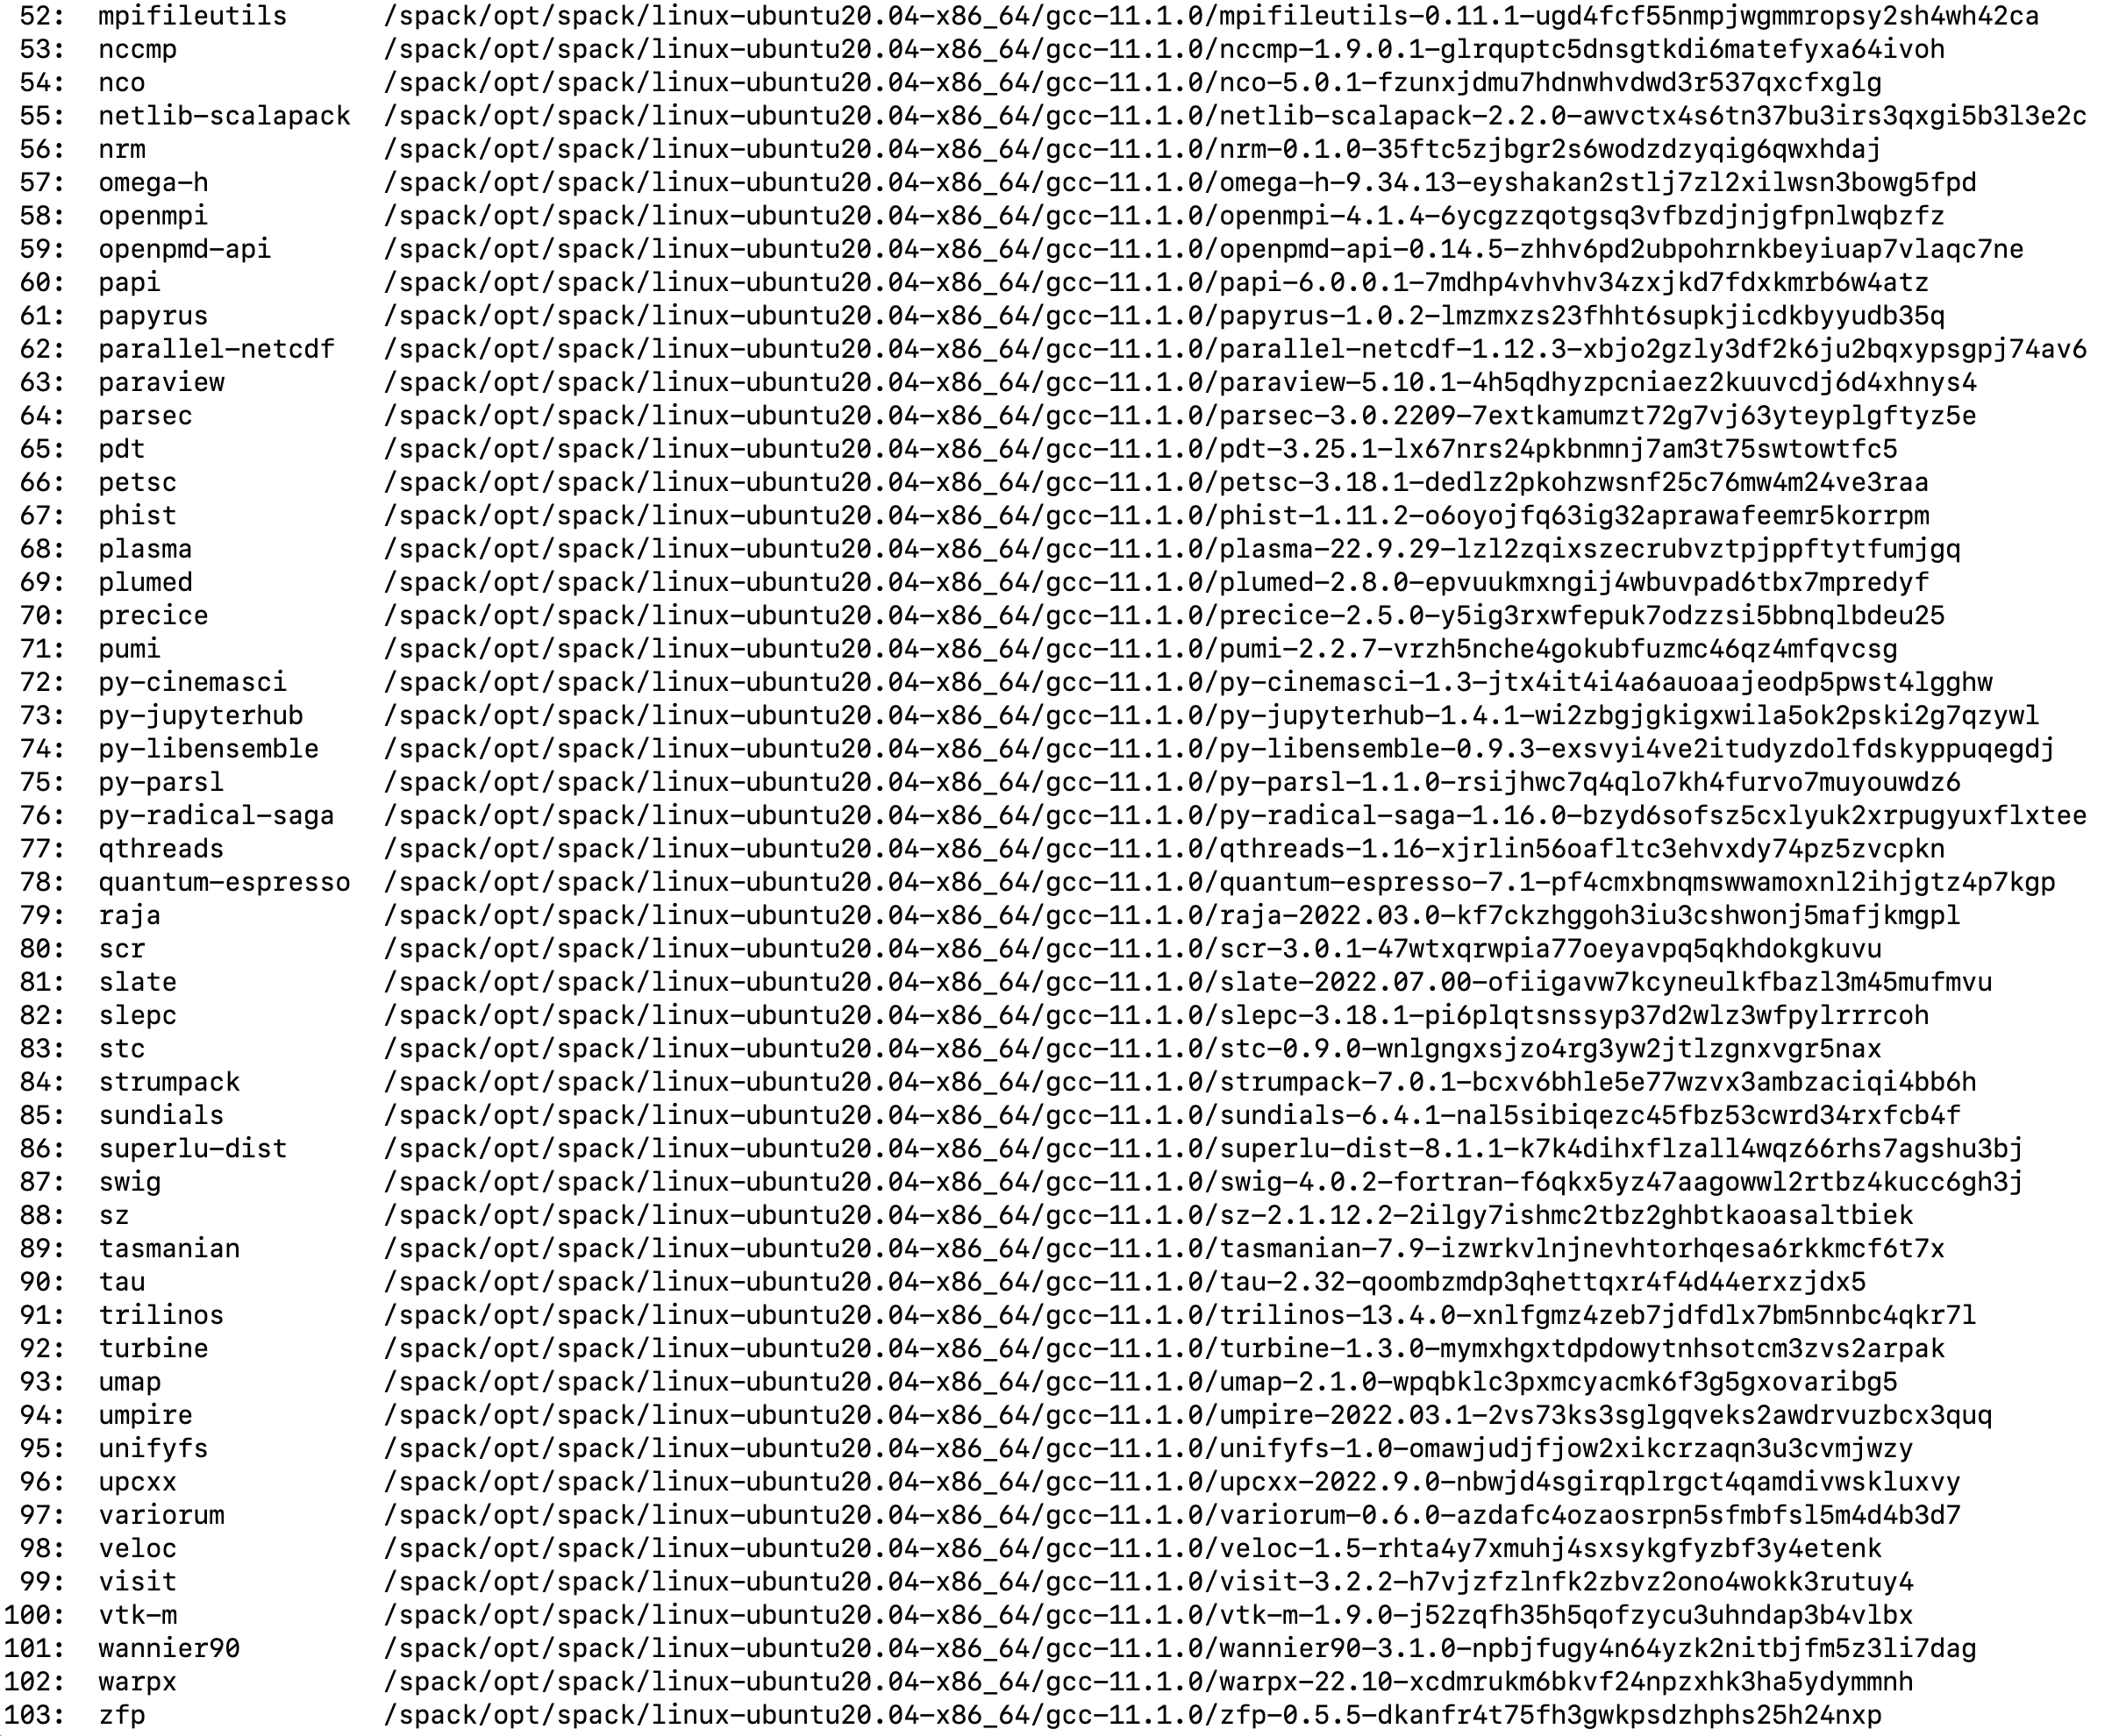
22.11 Release: 100 Official Products + dependencies (gcc, x86_64)
Languages:
Julia
Python
AI products with GPU support
Tensorflow
Pytorch
3D Visualization
Paraview
VisIt
TAU’s paraprof …

Slide 17
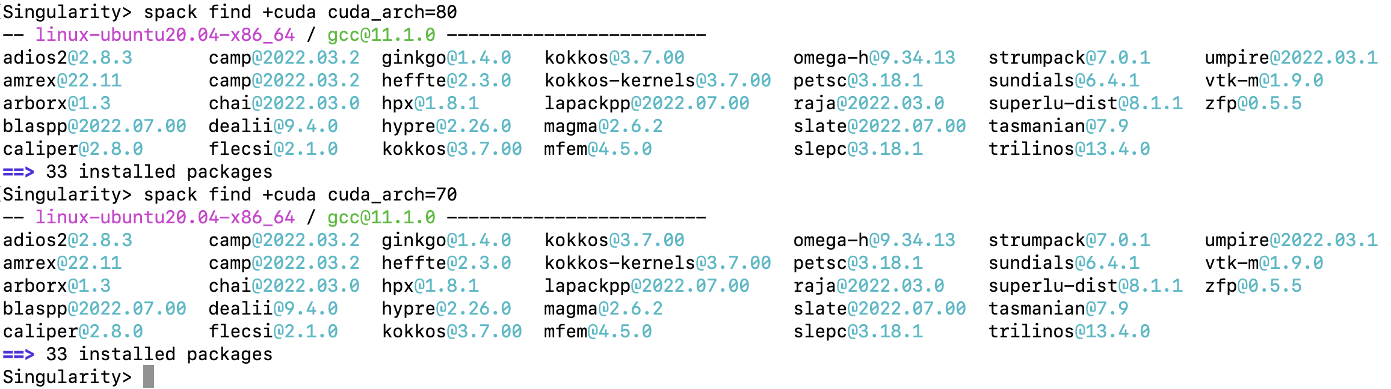
E4S Support for CUDA variants on x86_64

Slide 18
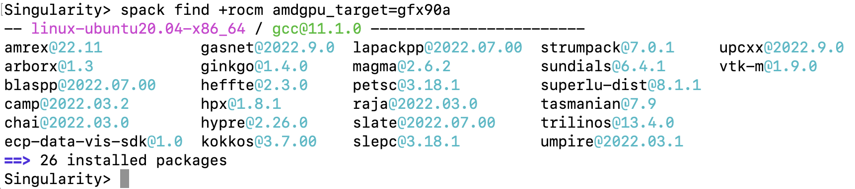
E4S Support for ROCm variants for MI250X (gfx90a) on x86_64

Slide 19
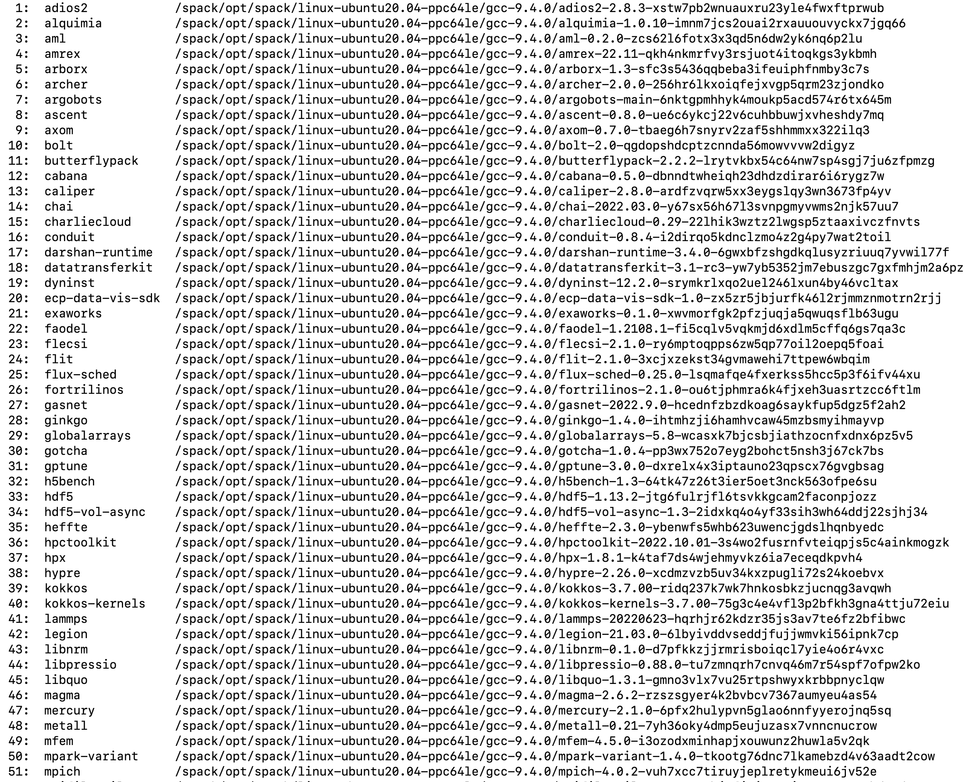
22.11 Release: 100+ Official Products + dependencies (gcc, ppc64le)
GPU runtimes for IBM Power
CUDA 11.4
NVHPC 22.9
Languages
Julia
Python
AI packages for NVIDIA GPU
TensorFlow
PyTorch

Slide 20
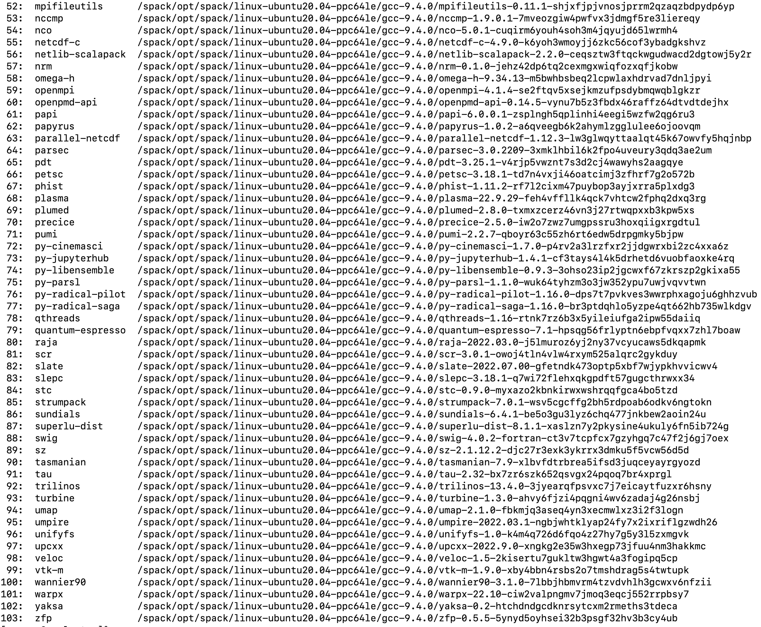
22.11 Release: 100+ Official Products + dependencies (gcc, ppc64le)
GPU runtimes for IBM Power
CUDA 11.4
NVHPC 22.9
Languages
Julia
Python
AI packages for NVIDIA GPU
TensorFlow
PyTorch

Slide 21
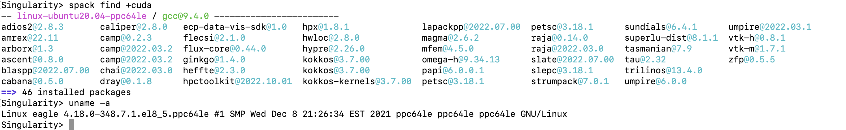
E4S Support for CUDA variants on ppc64le

Slide 22
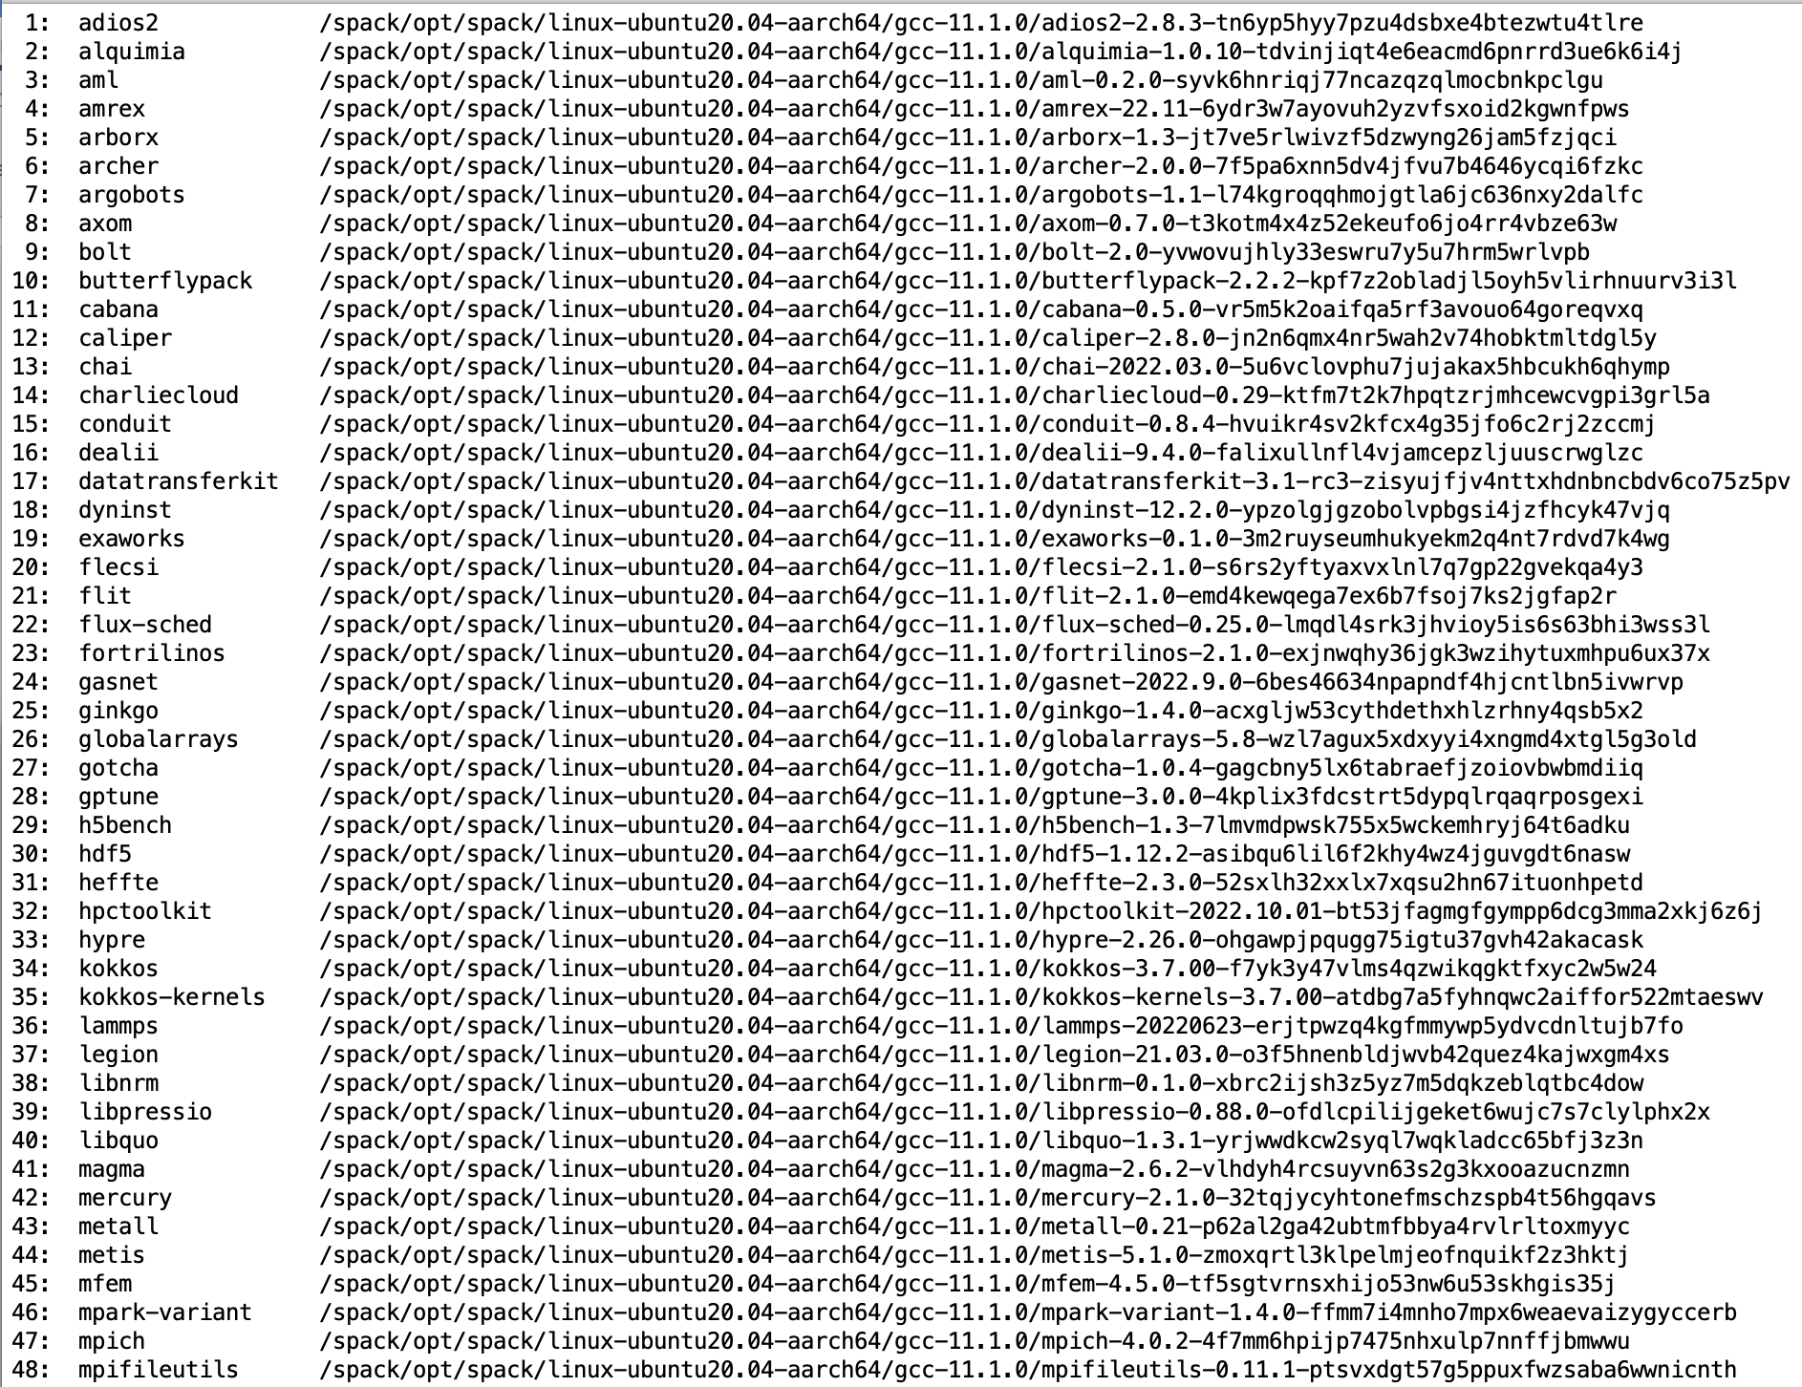
22.11 Release: 97 Official Products + dependencies (gcc, aarch64)
GPU runtimes for aarch64
CUDA 11.7.1
NVHPC 22.9
Languages
Julia
Python
AI packages for NVIDIA GPU
TensorFlow
PyTorch

Slide 23
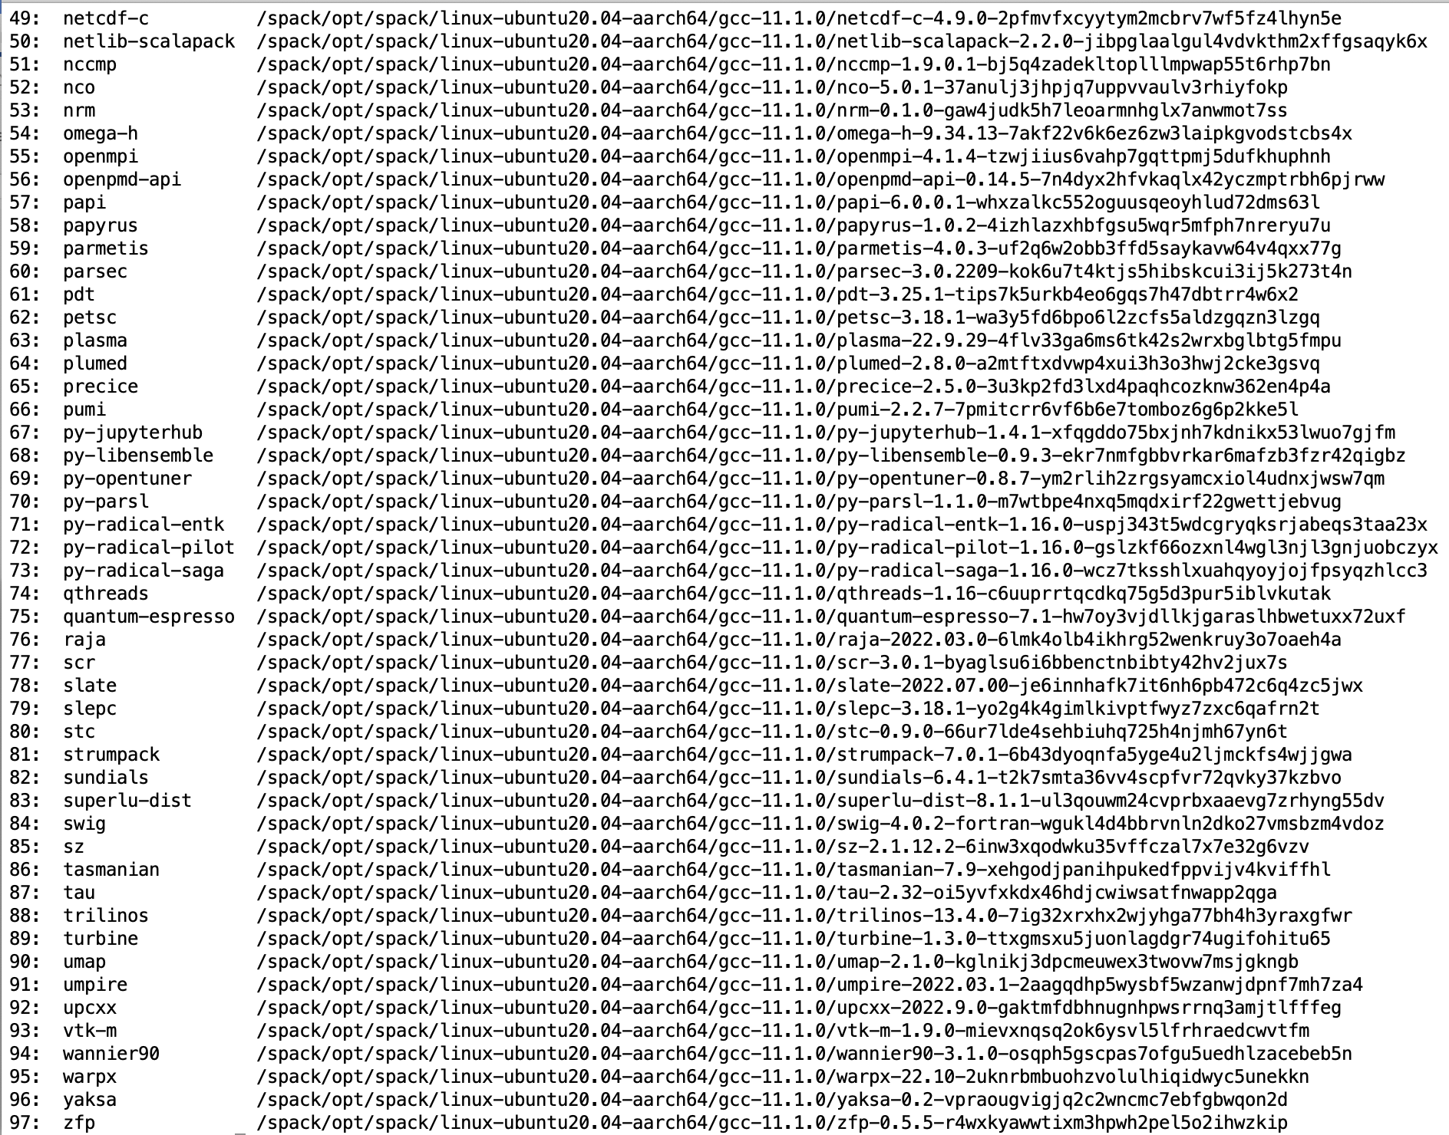
22.11 Release: 97 Official Products + dependencies (gcc, aarch64)
GPU runtimes for aarch64
CUDA 11.7.1
NVHPC 22.9
Languages
Julia
Python
AI packages for NVIDIA GPU
TensorFlow
PyTorch

Slide 24
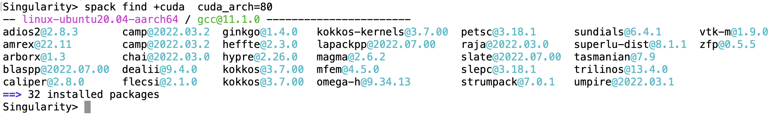
E4S Support for CUDA variants on aarch64
Support for A100 and T4 GPUs under aarch64

Slide 25
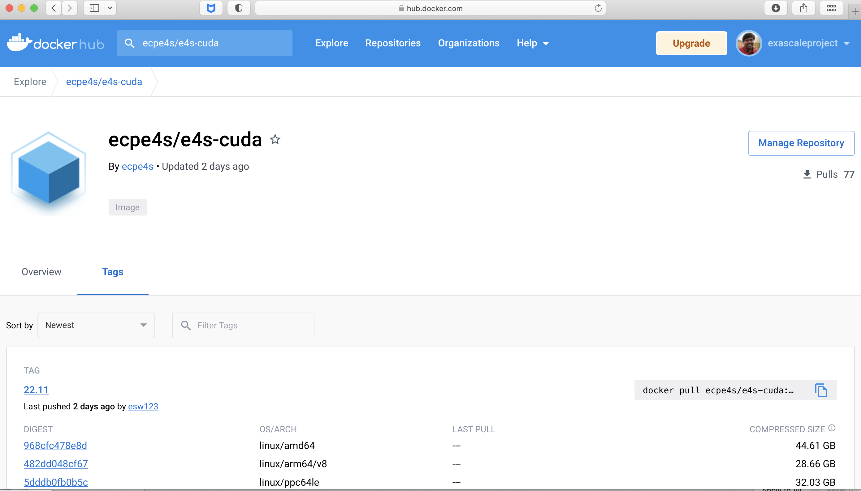
E4S 22.11 Release: GPU support for Docker Containers
100+ E4S Products
Support for GPUs
  x86_64
  ppc64le
  aarch64
% docker pull ecpe4s/e4s-cuda
Notes:
quick run through - what ECP ST is working on

Slide 26
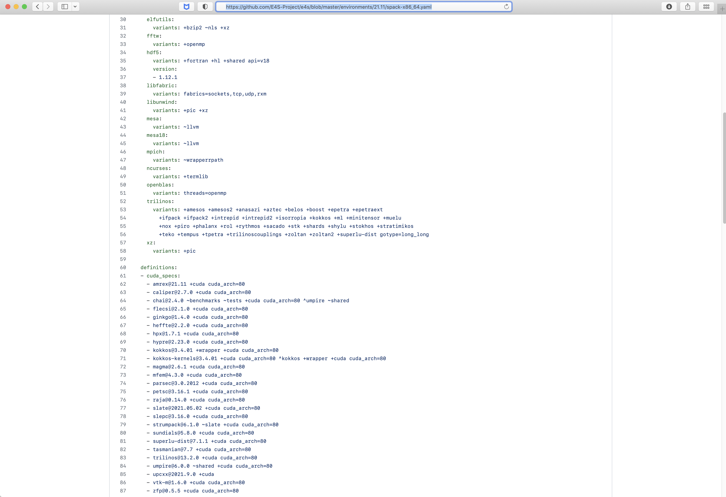
E4S bare-metal installation spack.yaml recipe
Trilinos variants
Built with CUDA
Notes:
quick run through - what ECP ST is working on

Slide 27
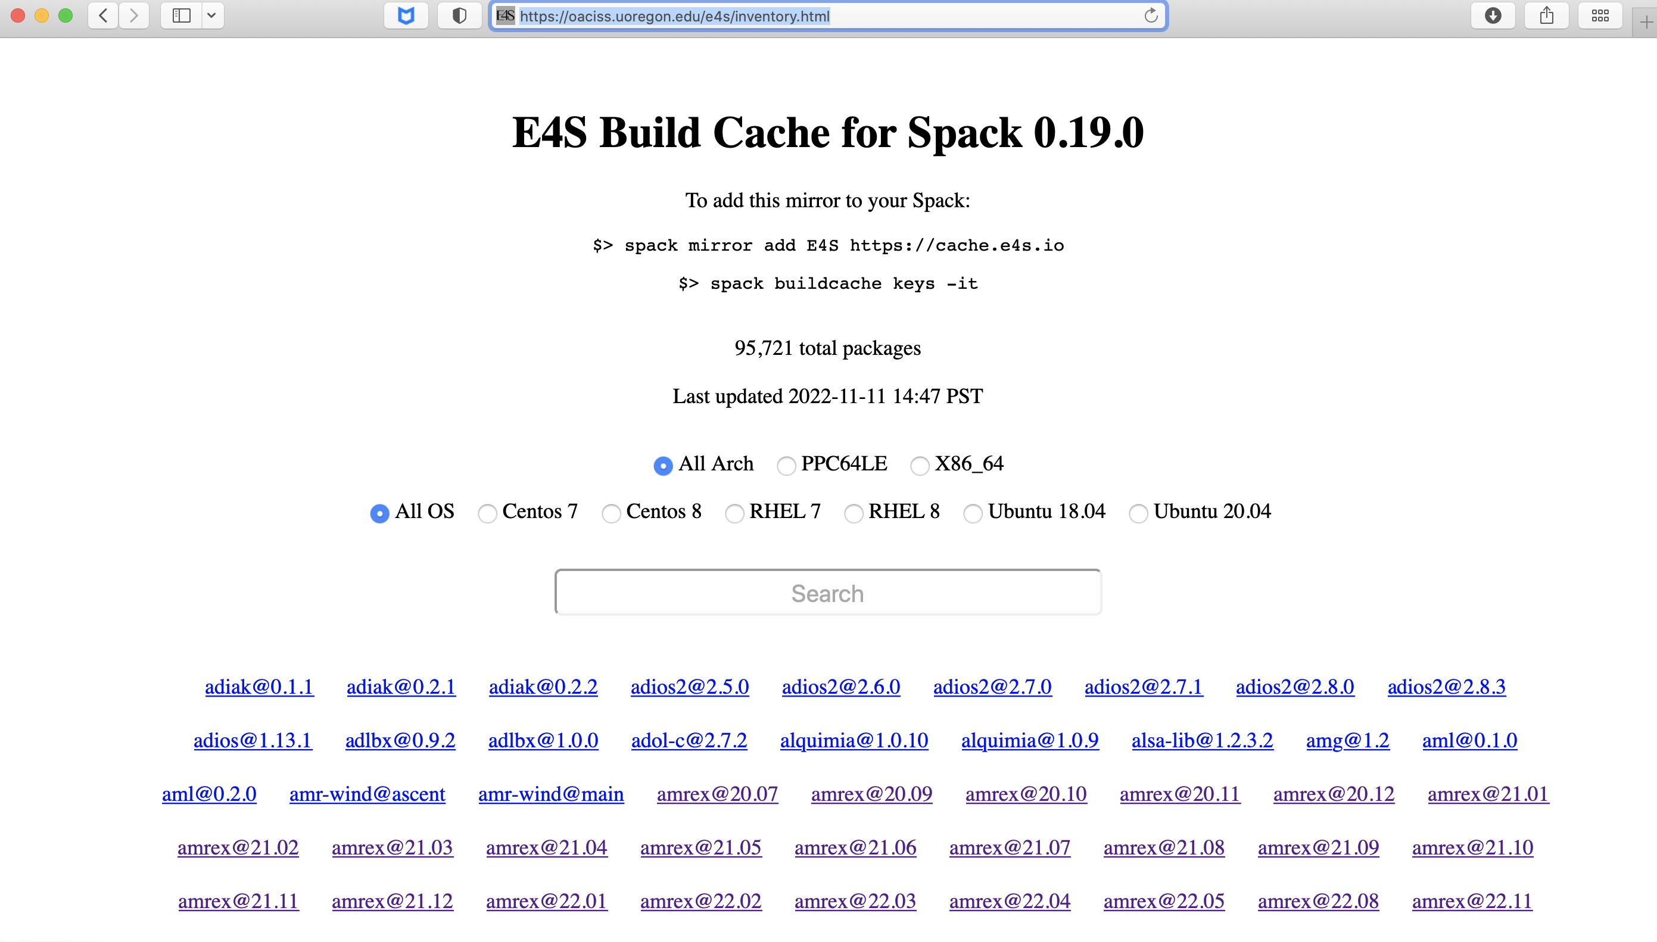
E4S Build Cache for Spack 0.19.0
Over 95,000 binaries!
No need to recompile from source code.

Slide 28
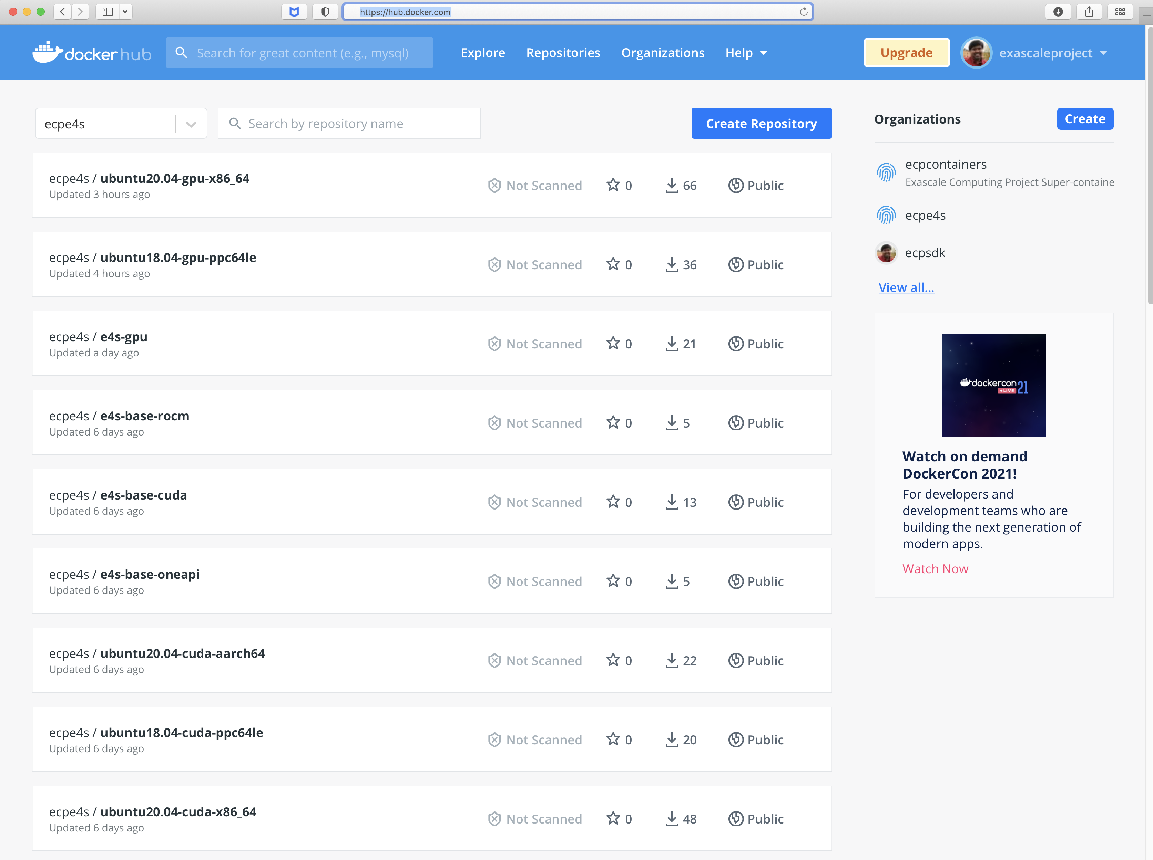
E4S Base Container Images for x86_64, ppc64le, and aarch64
Hub.docker.com
ecpe4s
Platforms:
  x86_64
  Ppc64le
  aarch64
GPU runtimes:
  CUDA
  ROCm
  oneAPI

Slide 29
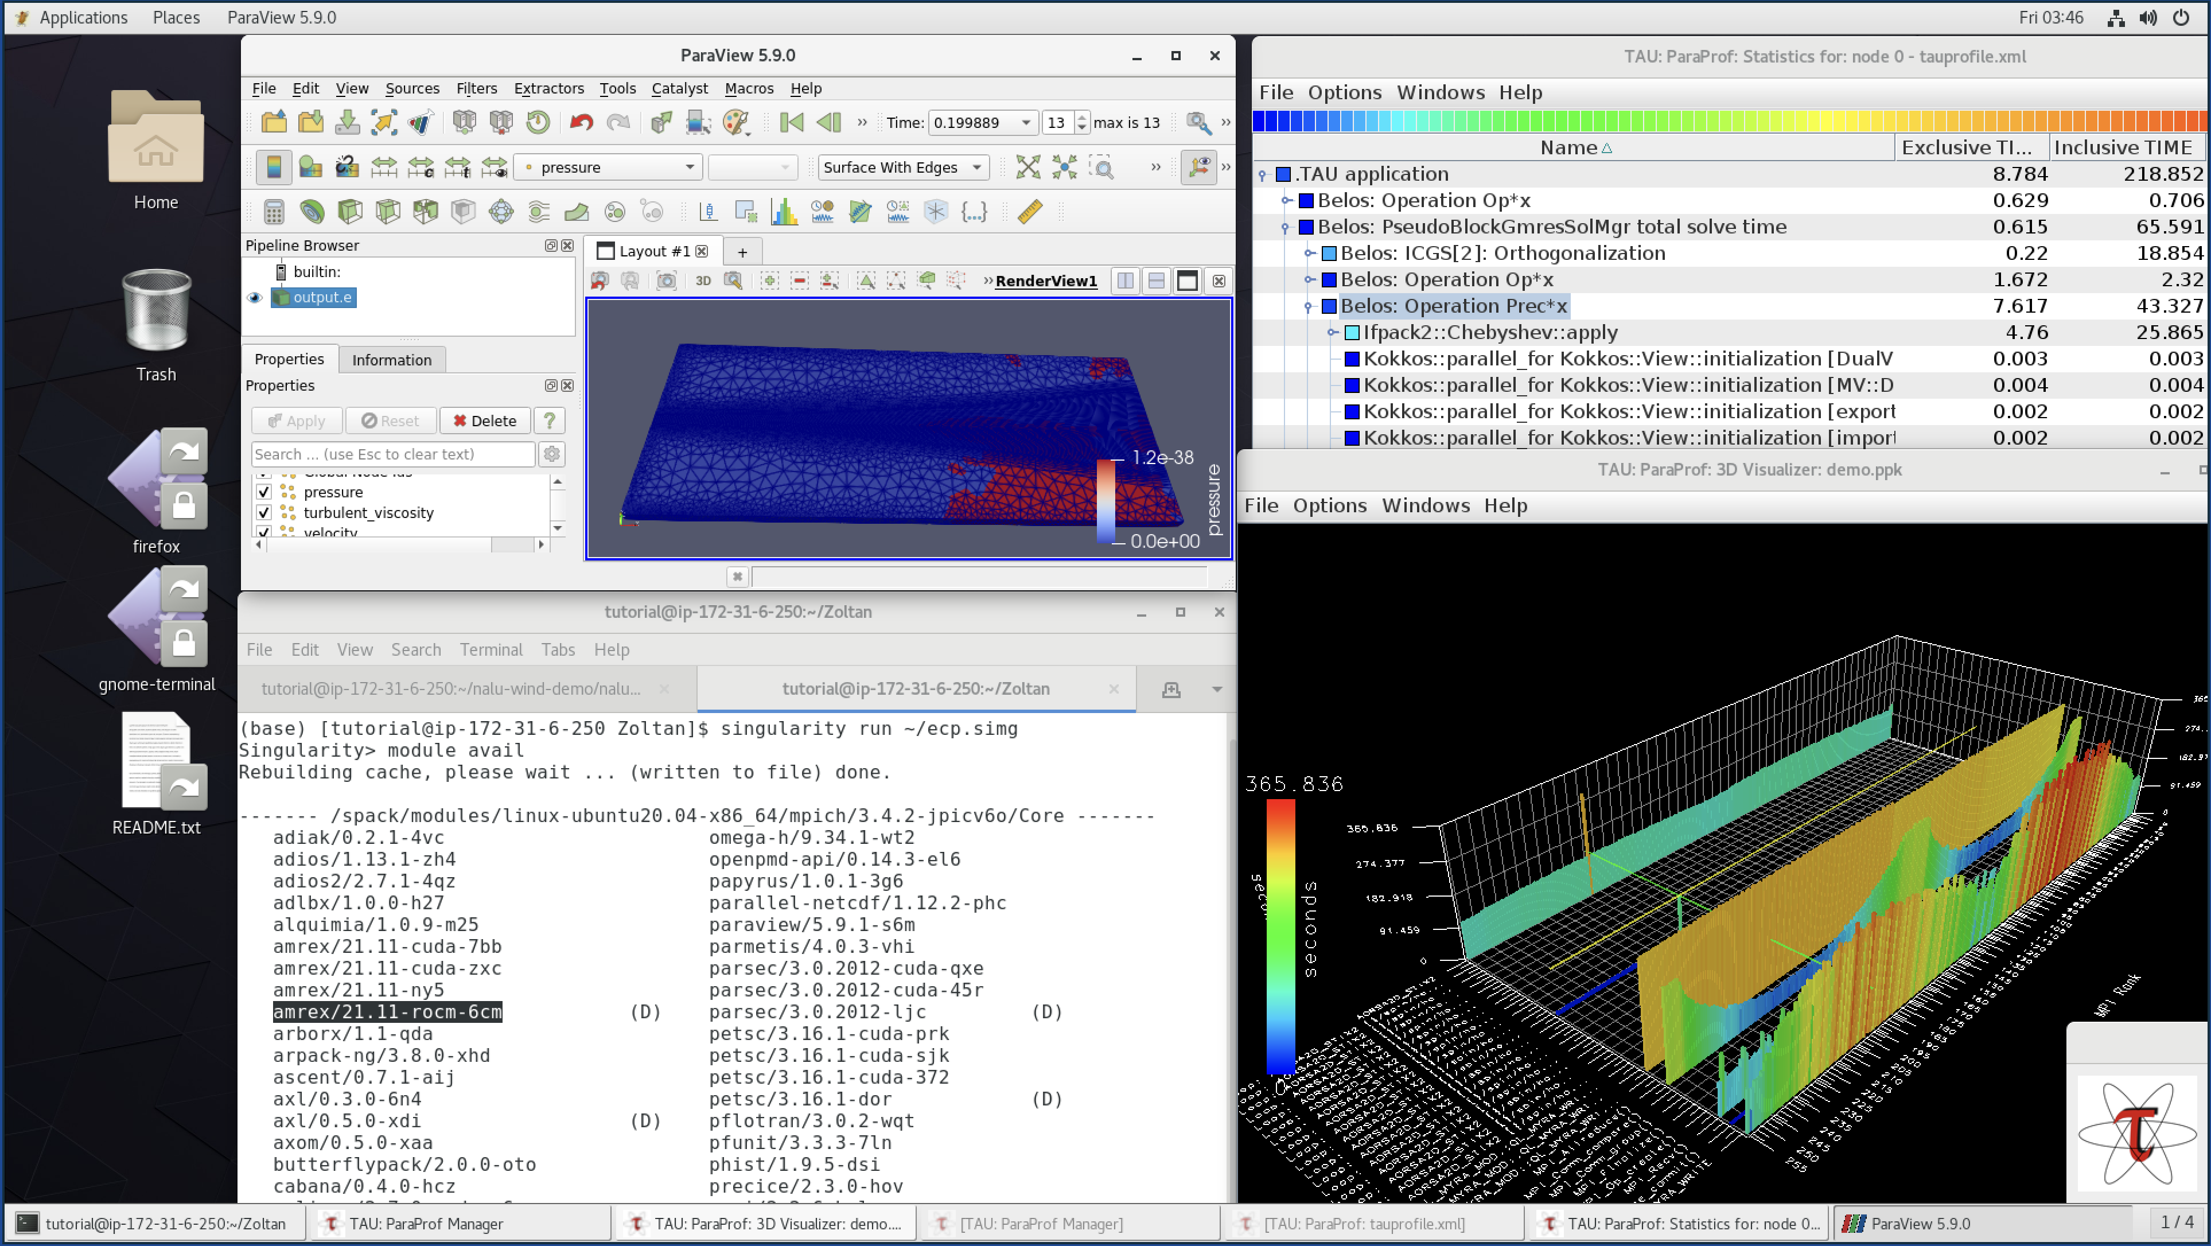
E4S 22.11 AWS image: US-West2 (OR)
E4S 22.11 AWS
Intel oneAPI
CUDA
NVHPC
ROCm
AWS DCV
Spack Build Cache
ECP: Nalu-Wind
Trilinos
OpenFOAM
ParaView
TAU
Docker
Shifter
Charliecloud
E4S Singularity…

Slide 30
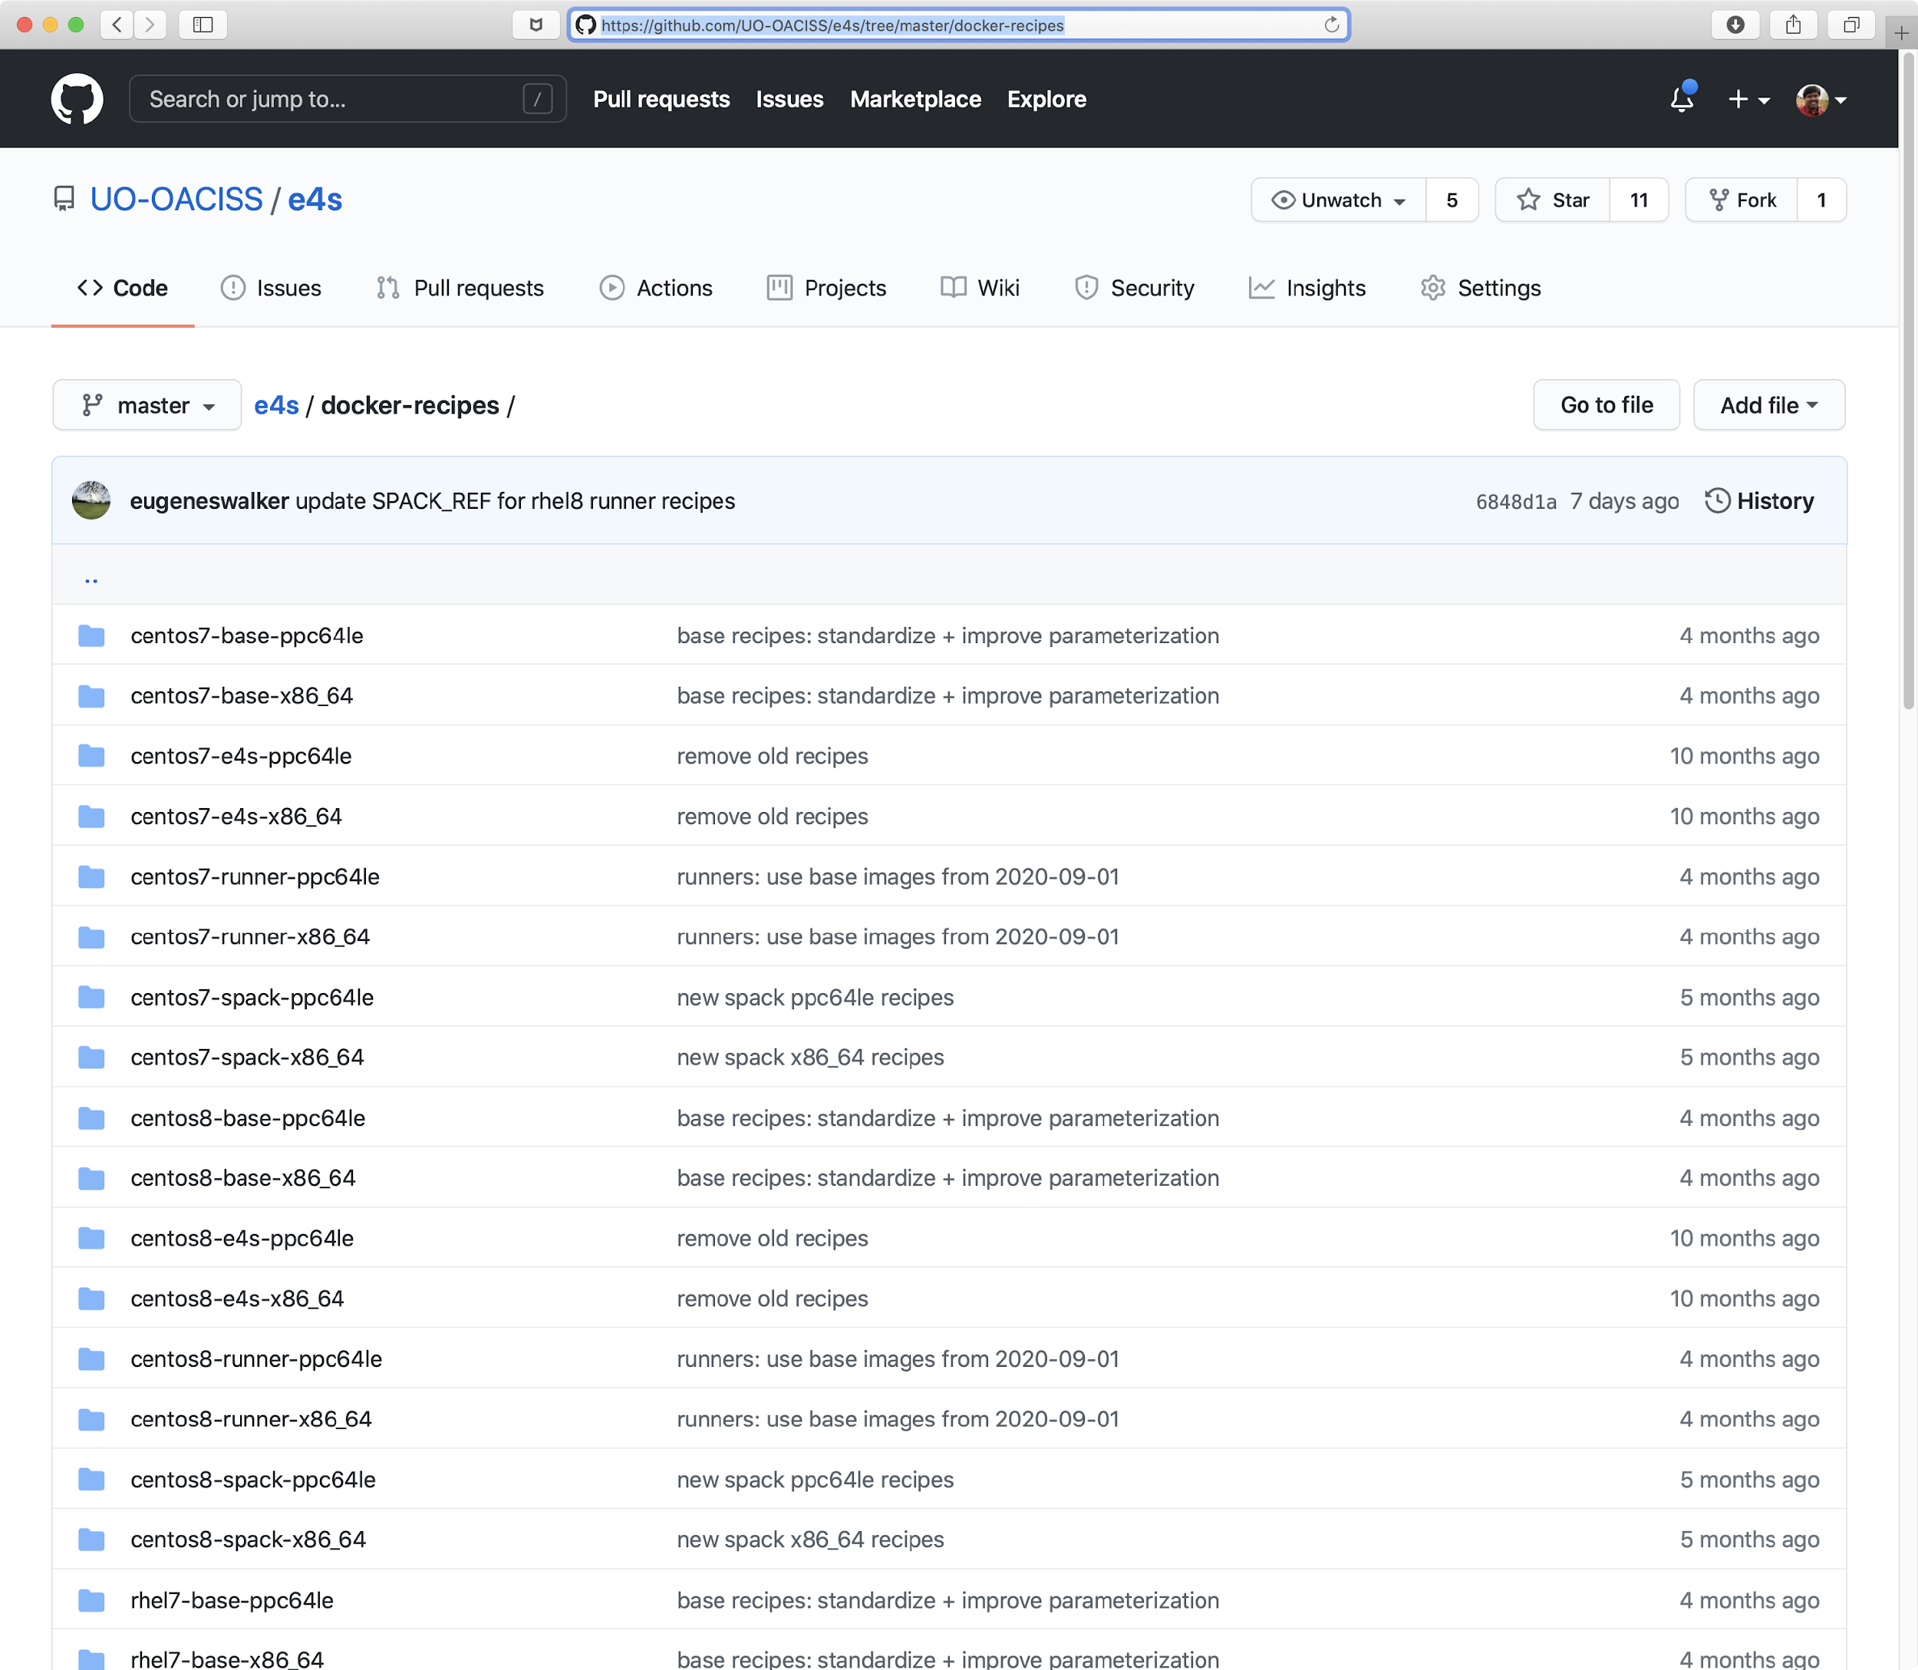
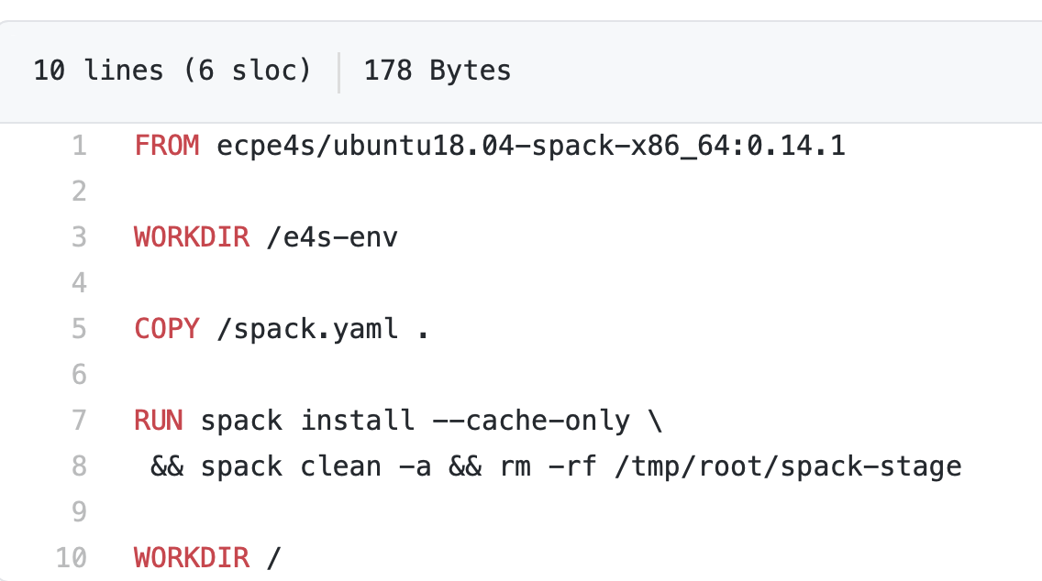
Multi-platform E4S Docker Recipes

Slide 31
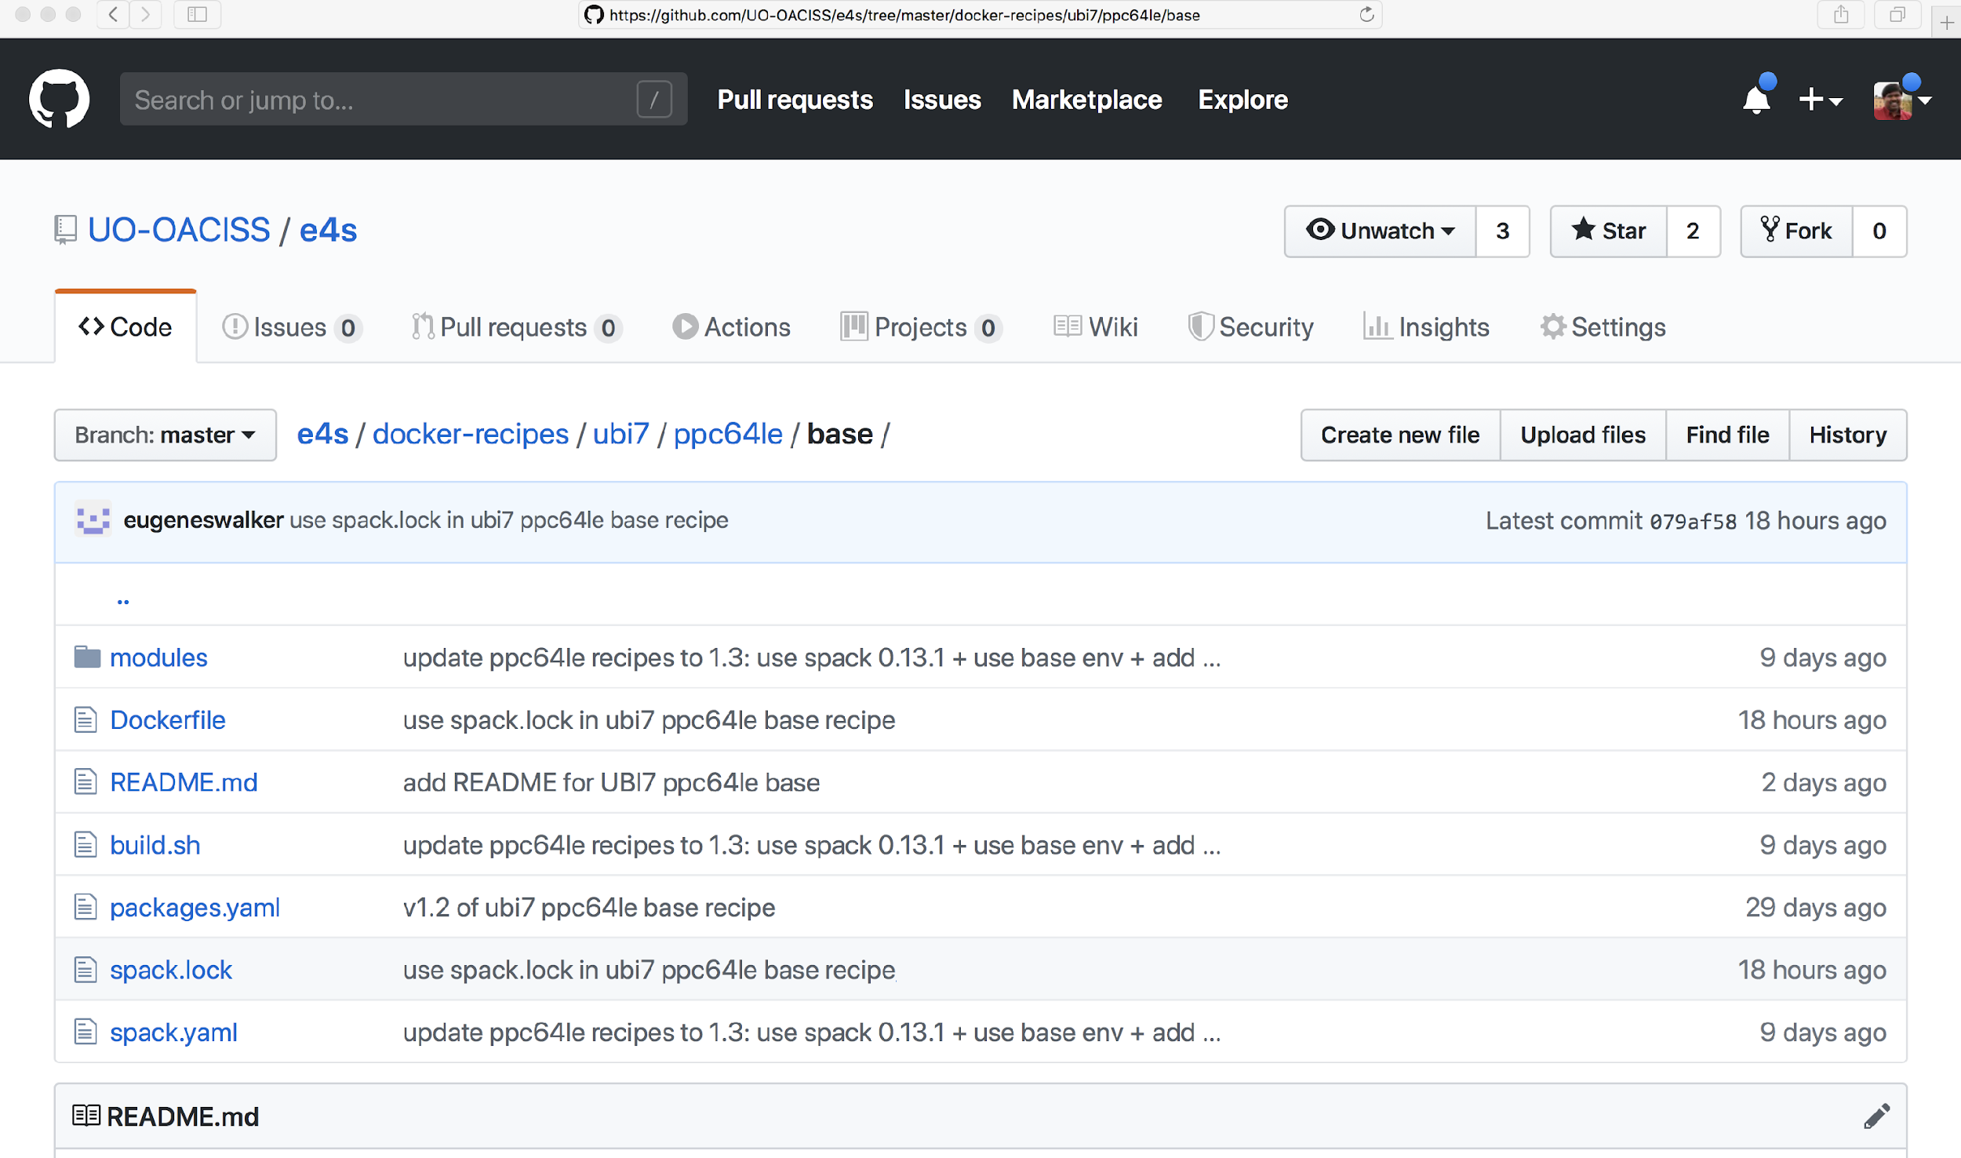
E4S: Multi-platform Reproducible Docker Recipes
E4S
x86_64
ppc64le
aarch64
https://e4s.io
Notes:
quick run through - what ECP ST is working on

Slide 32
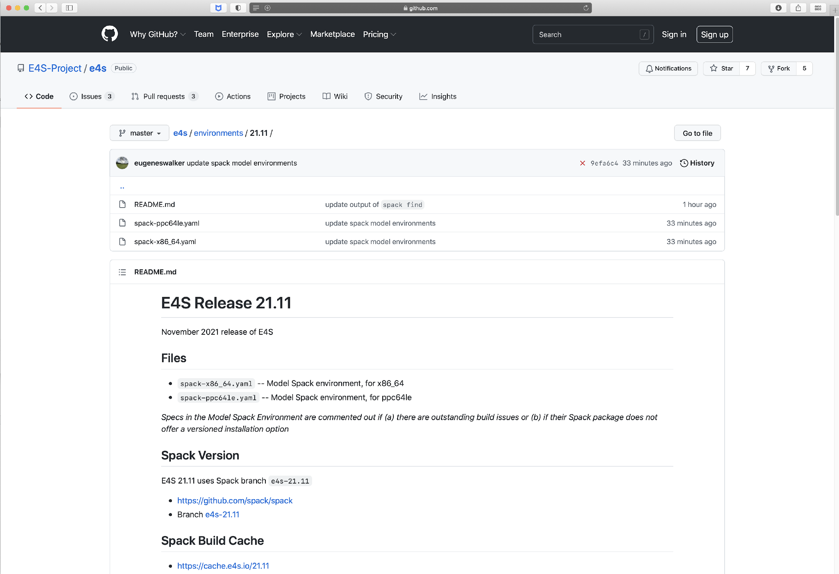
E4S for bare-metal installation

Slide 33
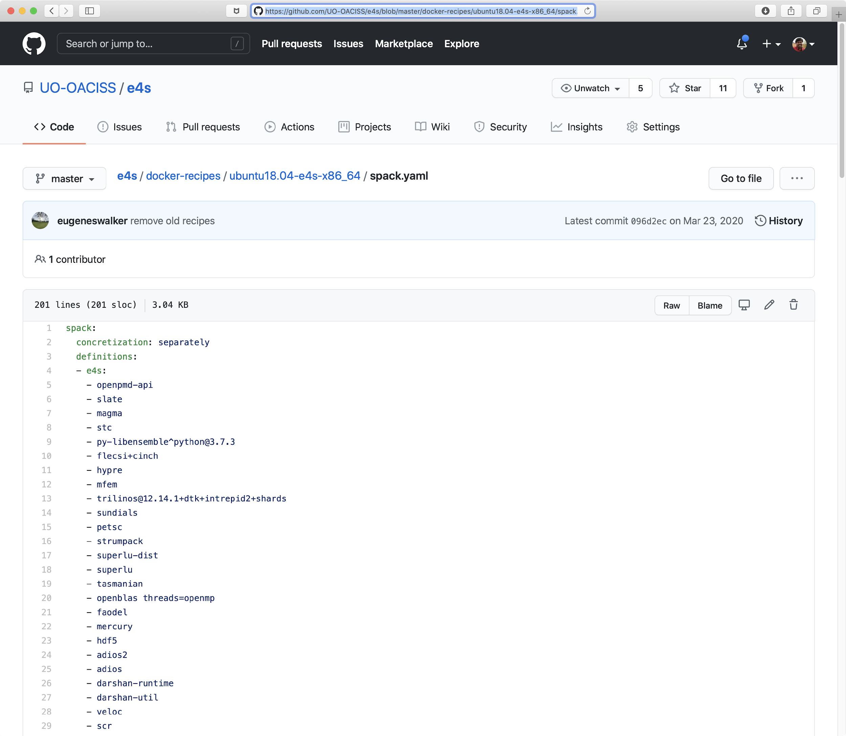
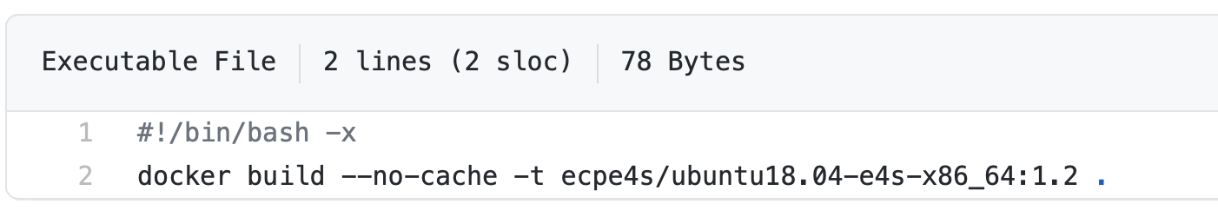
E4S Spack environment spack.yaml
Bare-metal install
% cat spack.yaml
% spack -e . install
Docker build:

Slide 34
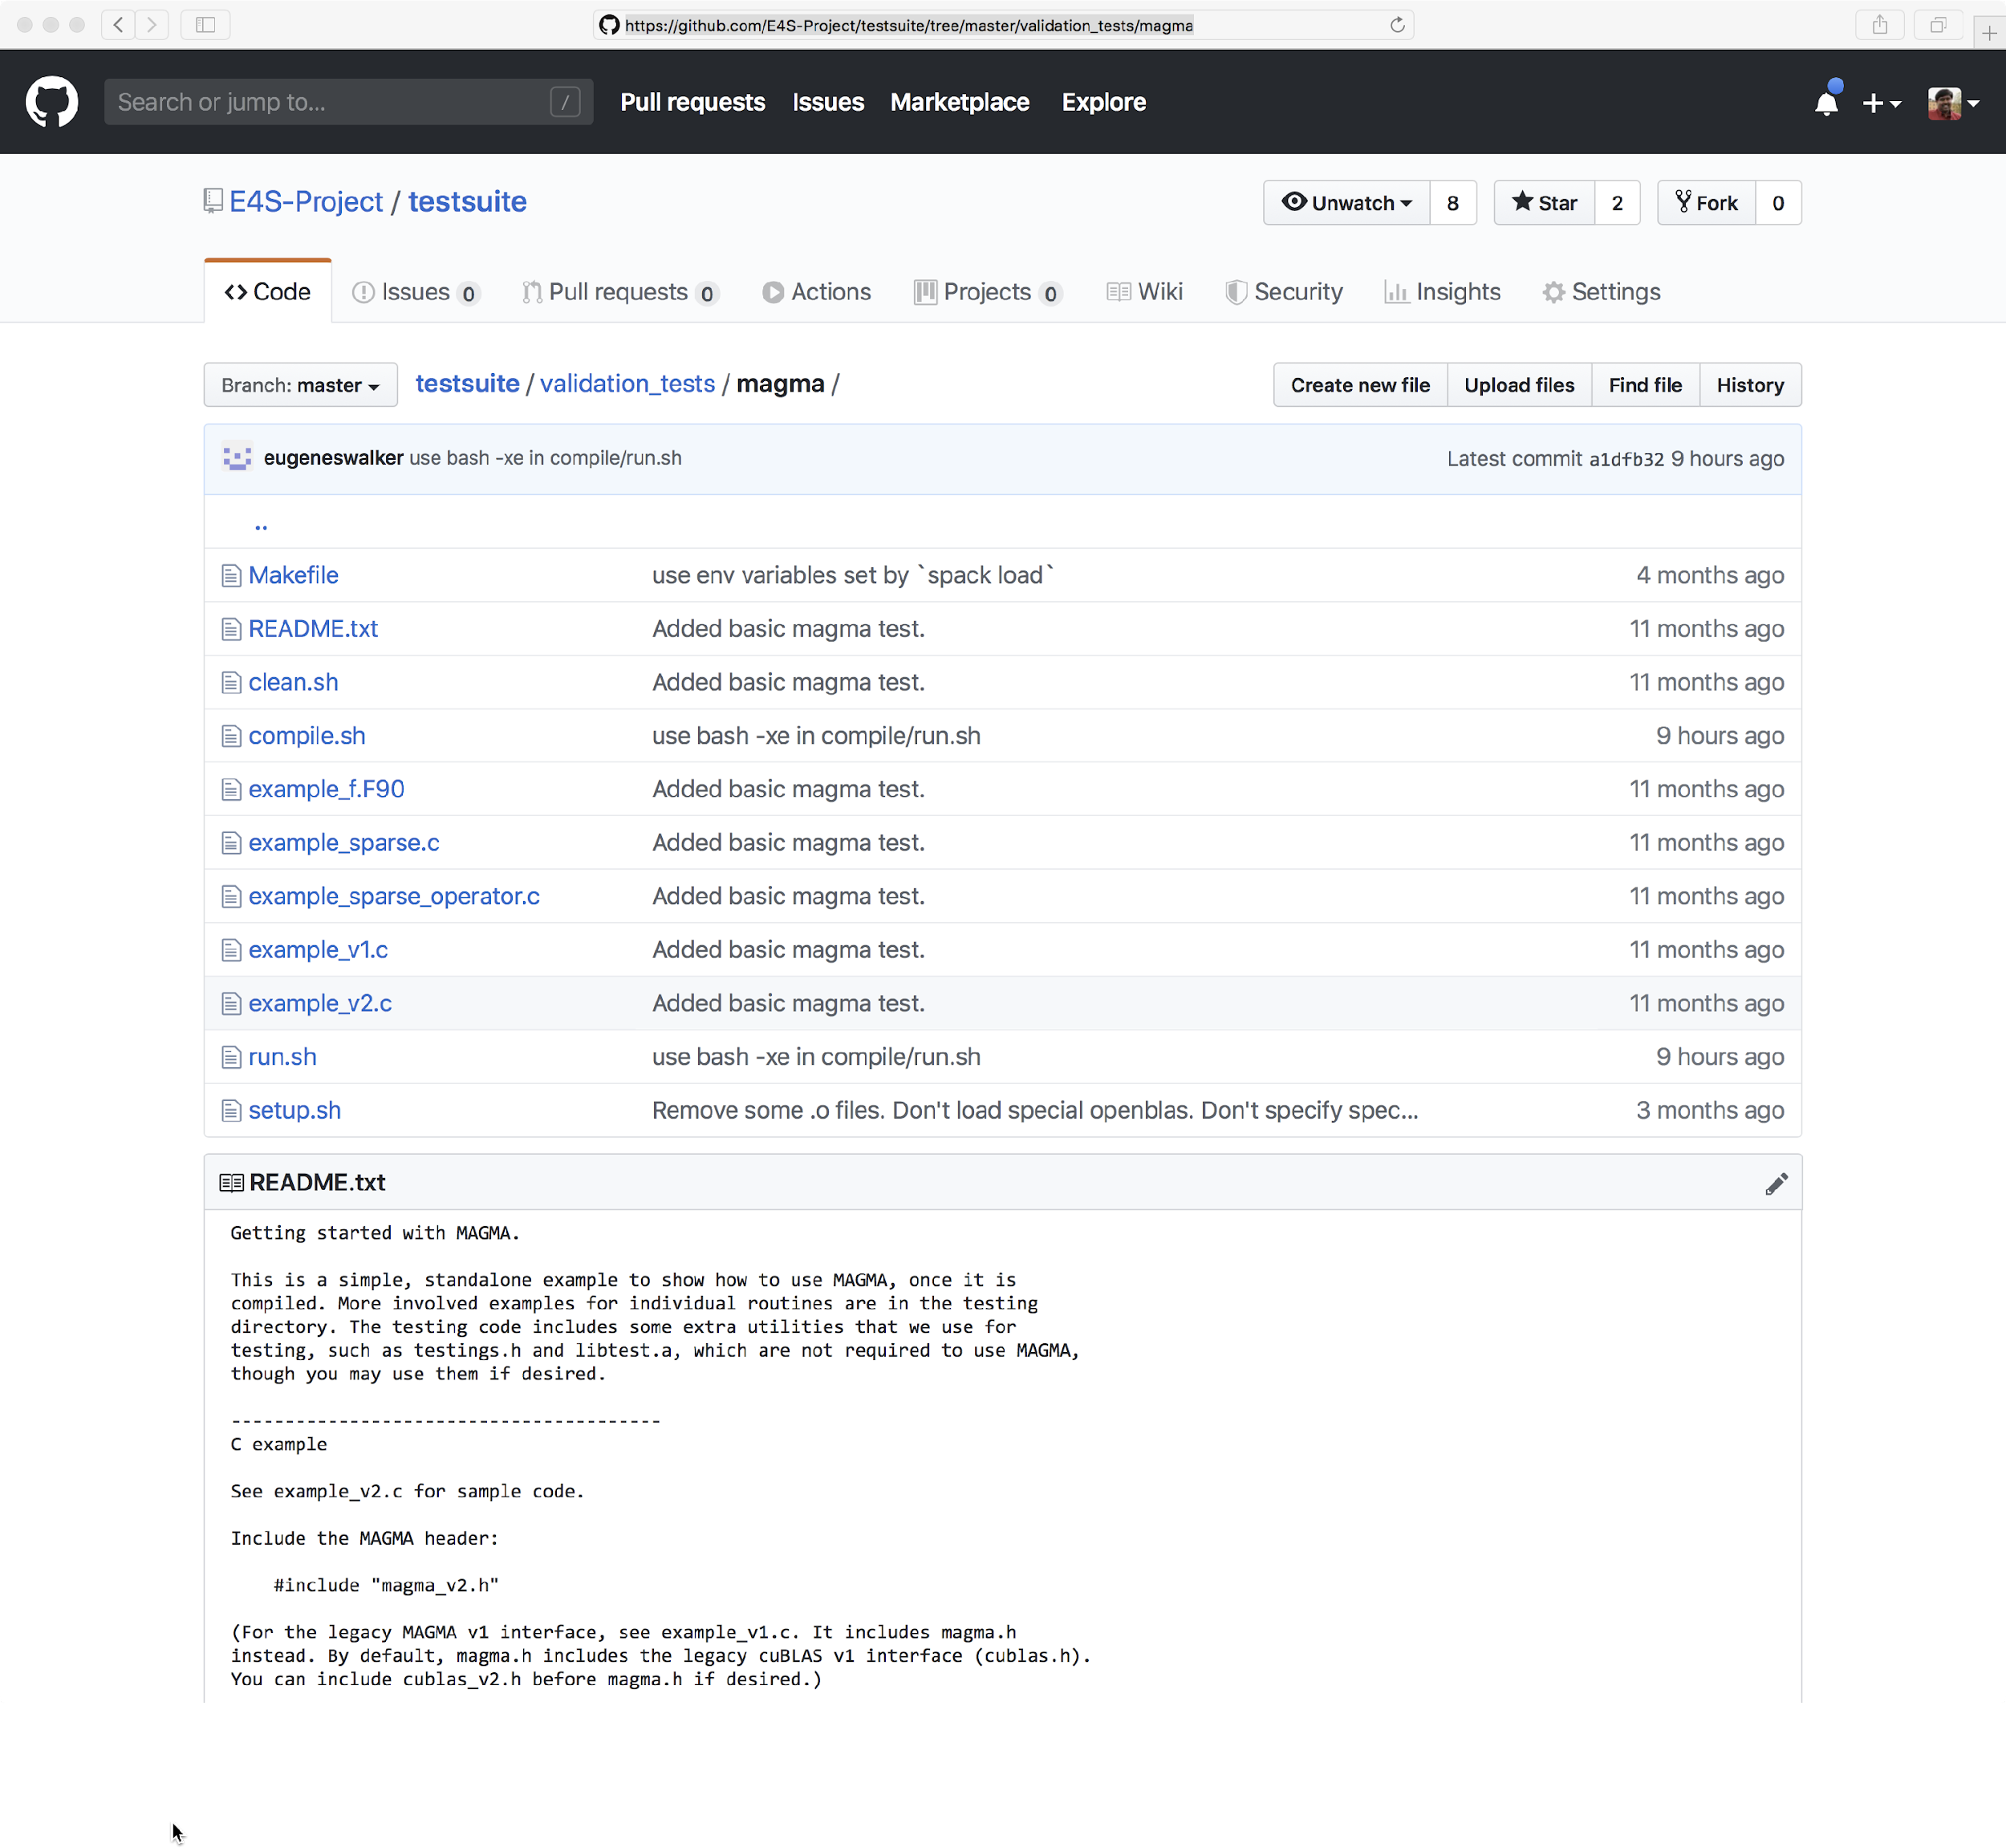
E4S Validation Test Suite
Provides automated build and run tests
Validate container environments and products
LLVM validation test suite for DOE LLVM
git clone https://github.com/E4S-Project/testsuite.git
Notes:
quick run through - what ECP ST is working on

Slide 35
E4S Support by ParaTools, Inc.
Deliverable STED01-27: E4S Support
Deliverable STED01-25: E4S Installation
Deliverable STED01-29: E4S AD engagement
https://dashboard.e4s.io
A single dashboard to monitor progress and report:
https://e4s.io/talks/E4S_Support_Jan23.pdf
Support for E4S:
https://www.paratools.com/E4S/

Slide 36
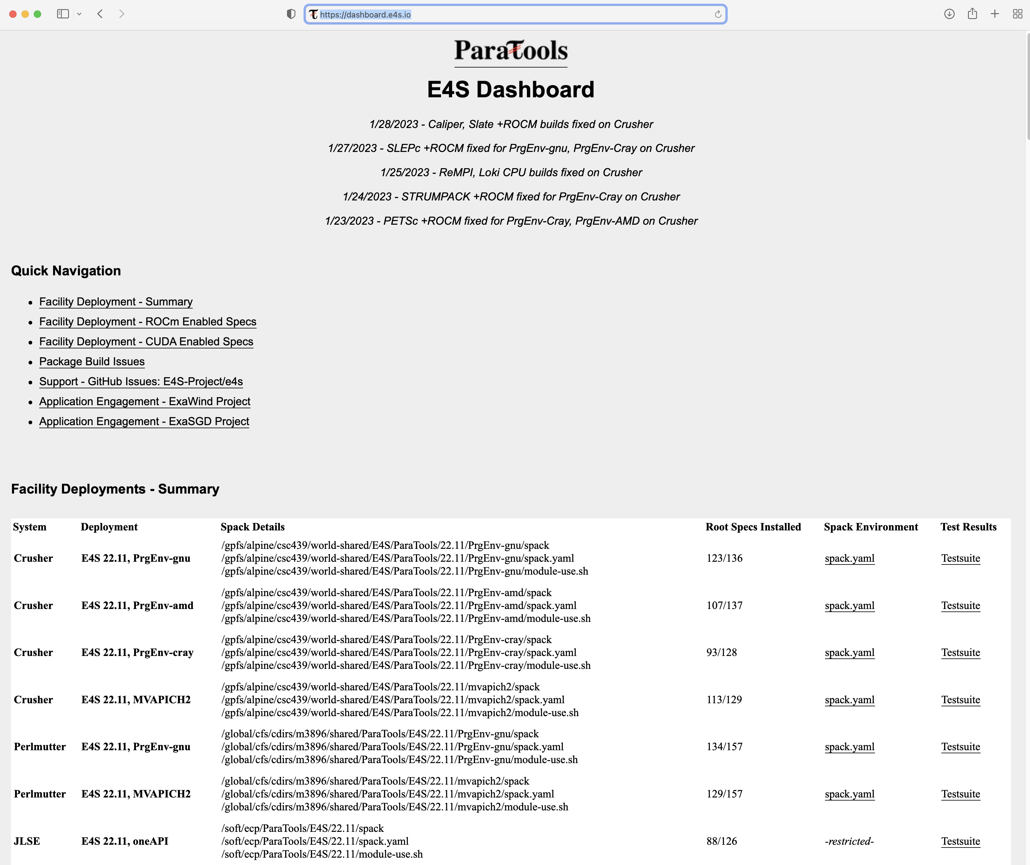
Facility Deployment Progress: https://dashboard.e4s.io

Slide 37
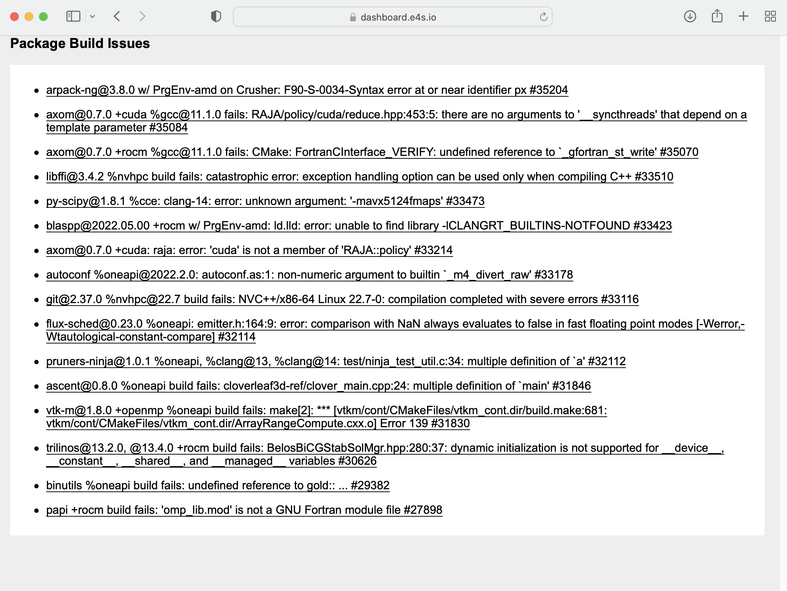
Dashboard for Monitoring Progress: Spack build issues

Slide 38
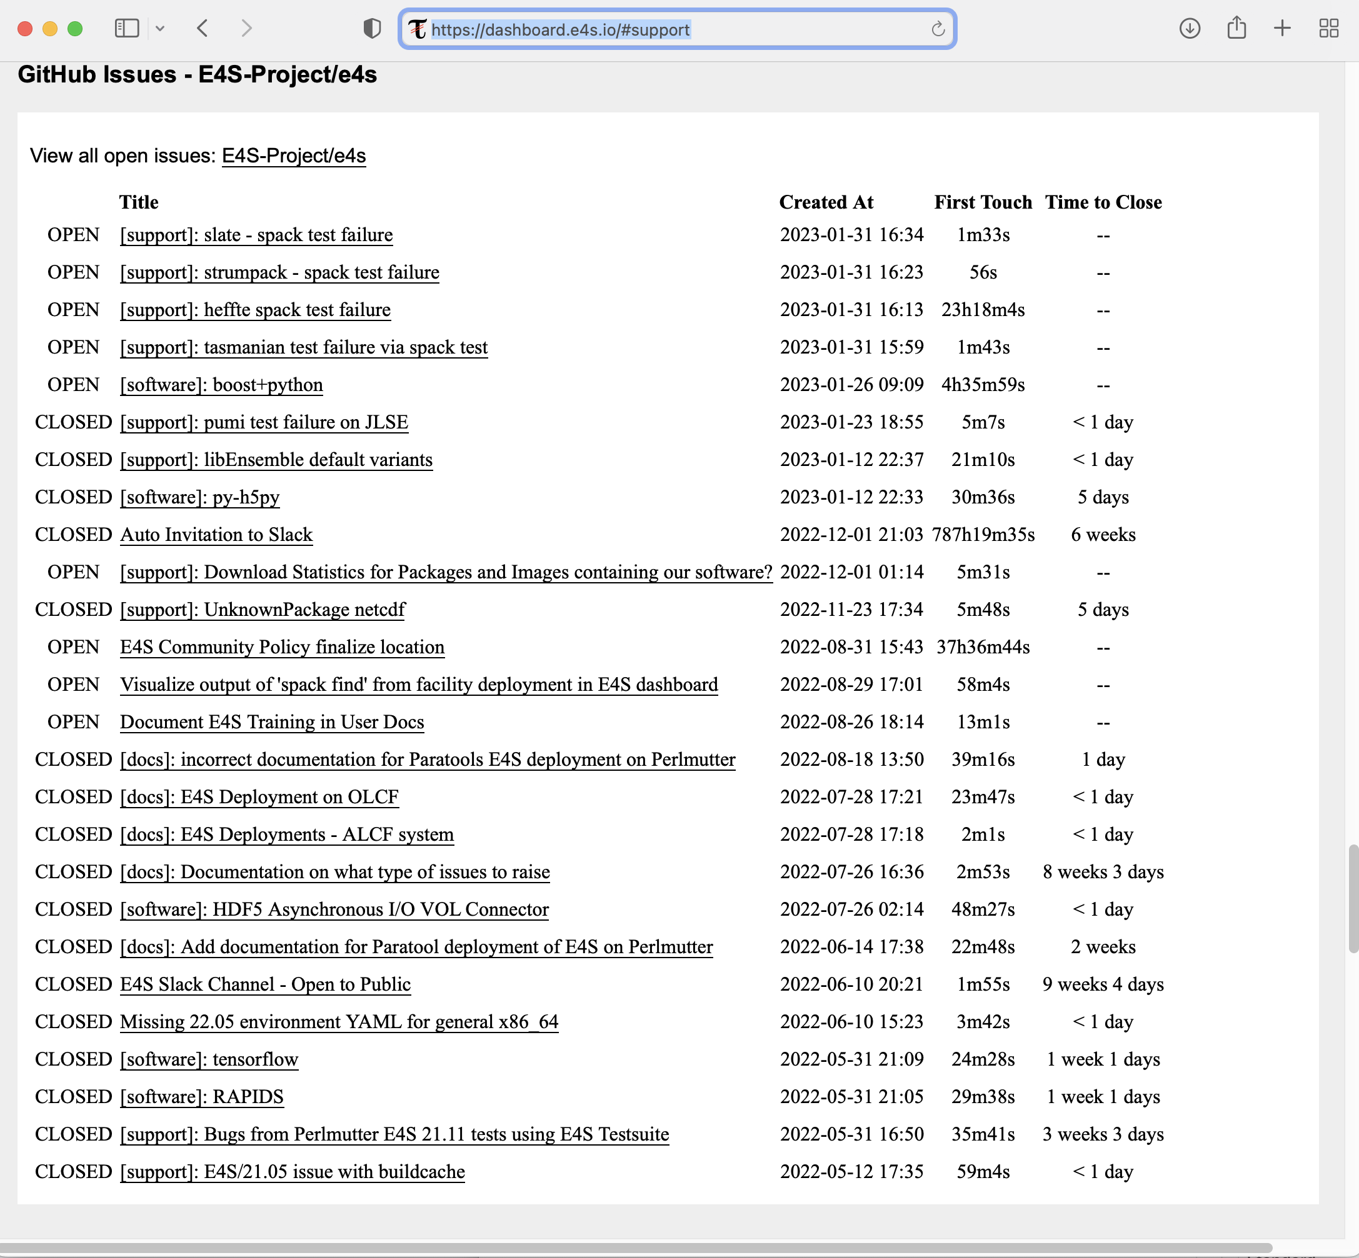
Dashboard for Monitoring Progress: Support Tickets Open and Resolved
First touch and time to close statistics.

Slide 39
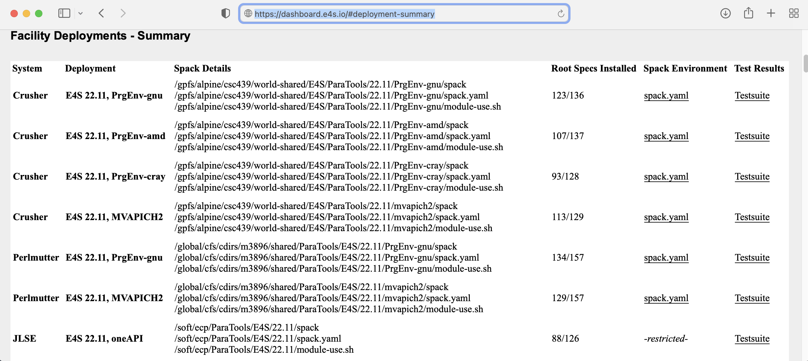
E4S 22.11 Installation at DOE Facilities

Slide 40
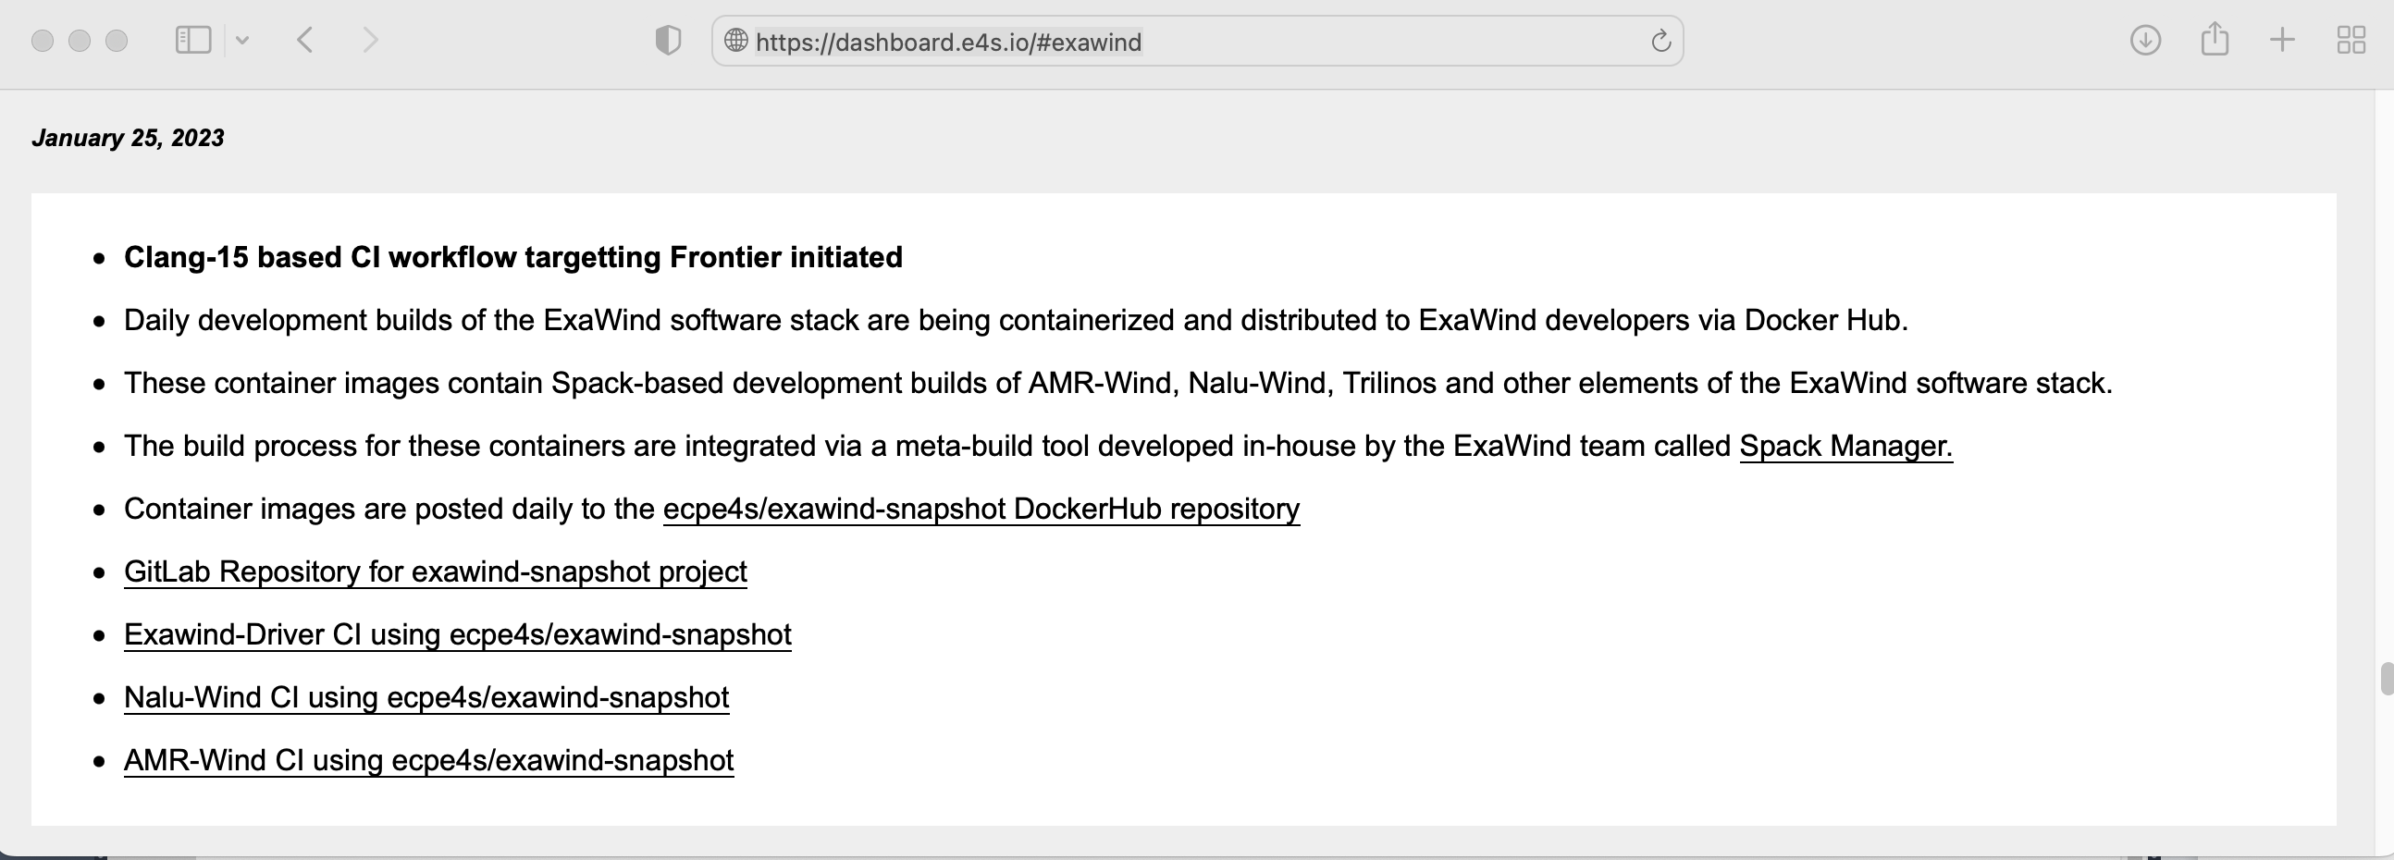
Progress Report of E4S Support for ExaWind by ParaTools, Inc.

Slide 41
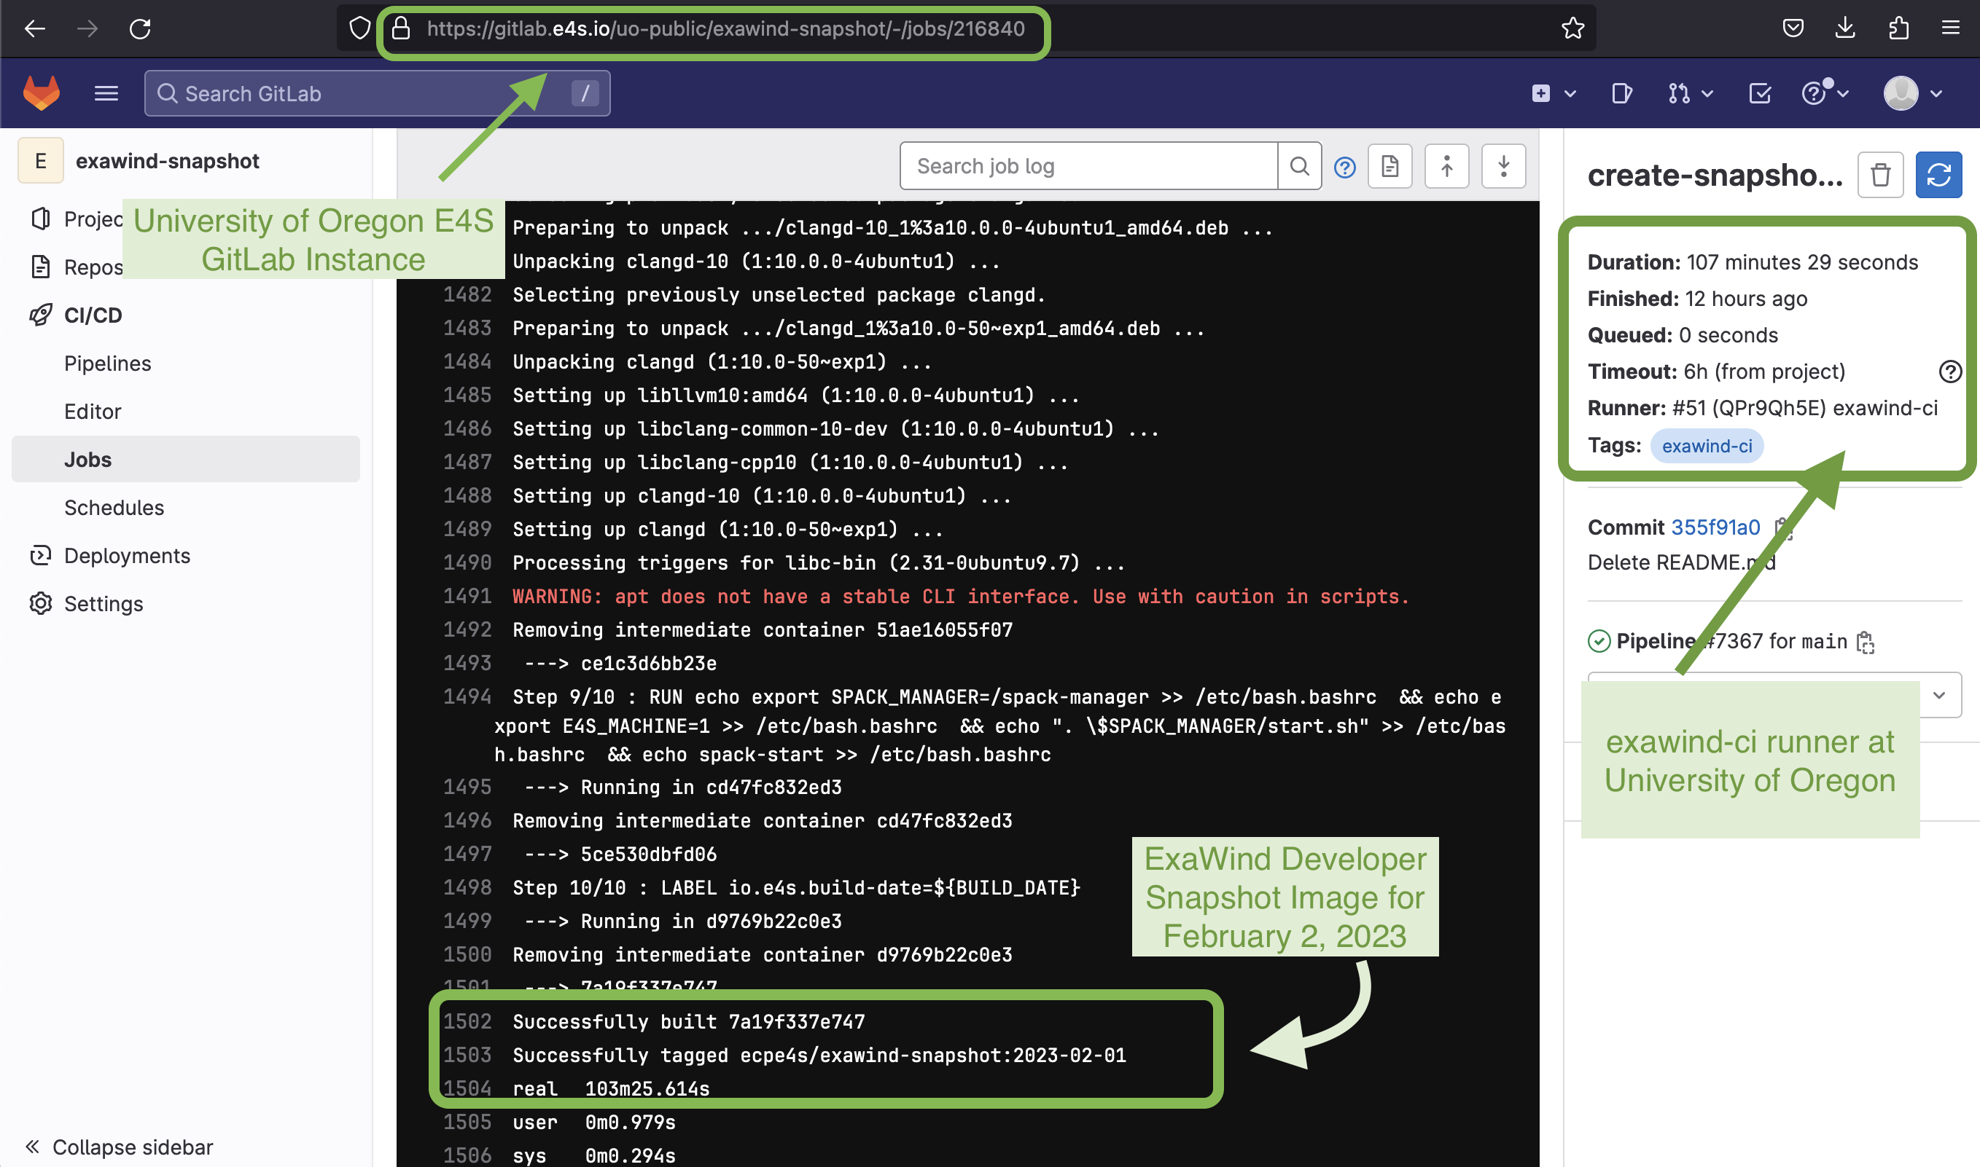
ExaWind GitLab Integration
ExaWind: Screenshot shows the CI log for the Nightly Development Snapshot of ExaWind built on February 1, 2023 via gitlab.e4s.io at the University of Oregon

Slide 42
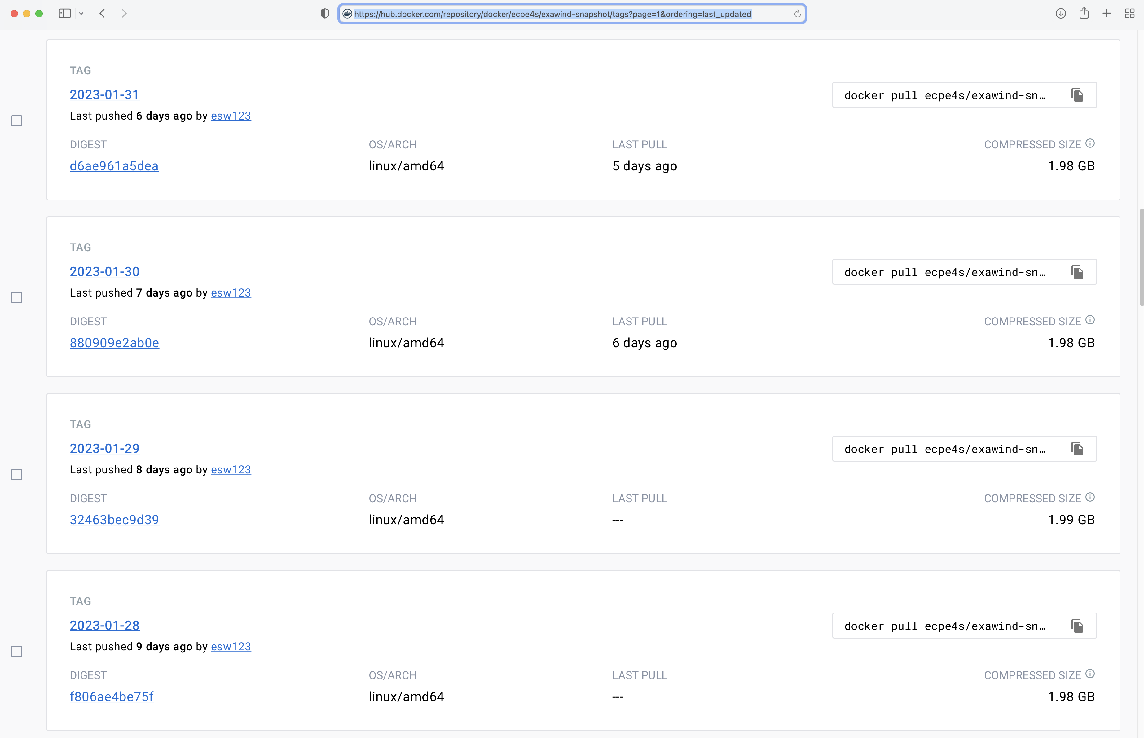
ExaWind CI: Container Image Artifacts on DockerHub (Jan. 31 ‘23)
https://hub.docker.com/repository/docker/ecpe4s/exawind-snapshot/

Slide 43
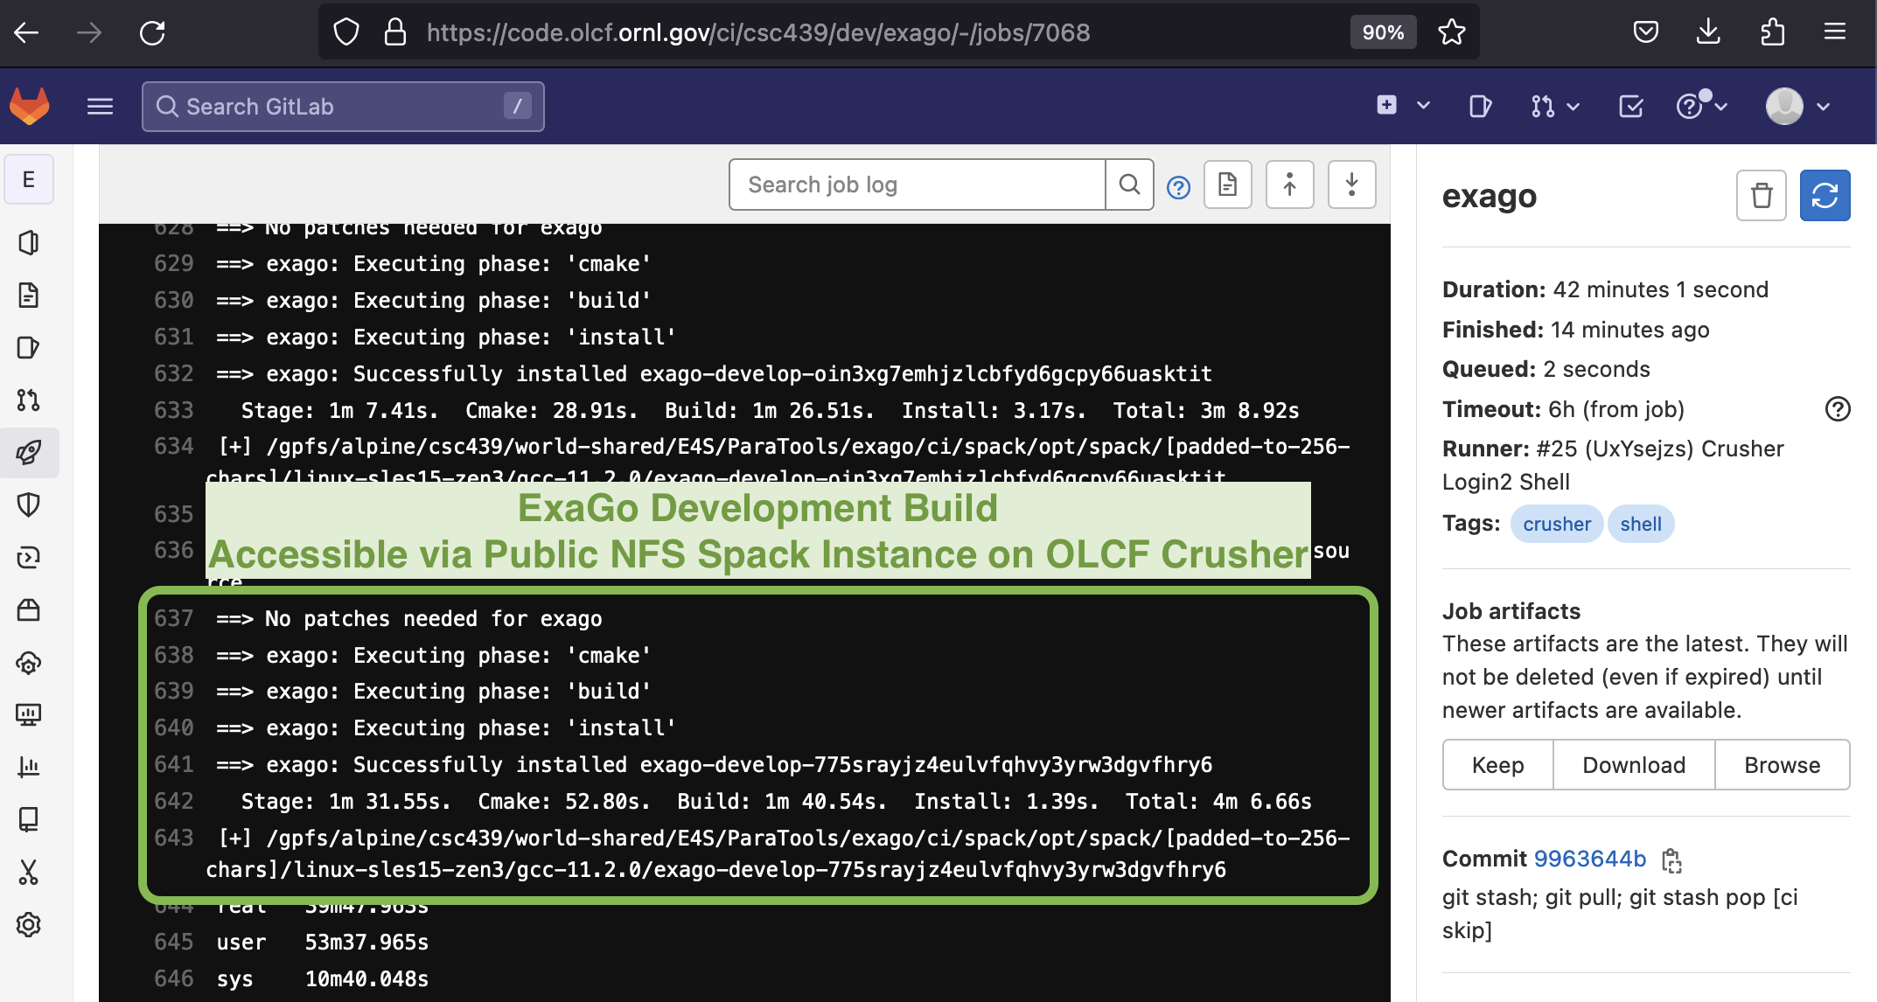
ExaSGD/ExaGo CI logs for pipeline at ORNL
ExaSGD/ExaGo: CI logs show successful build of ExaGo development branch, with ROCm variant enabled for AMD MI250X on OLCF Crusher, accessible via NFS Spack instance. CI logs shown here are from a job running February 1, 2023

Slide 44

e4s-cl: A tool to simplify the launch of MPI jobs in E4S containers
E4S containers support replacement of MPI libraries using MPICH ABI compatibility layer and Wi4MPI [CEA] for OpenMPI replacement.
Applications binaries built using E4S can be launched with Singularity using MPI library substitution for efficient inter-node communications.
e4s-cl is a new tool that simplifies the launch and MPI replacement.
  e4s-cl init --backend [singularity|shifter|docker] --image <file> --source <startup_cmds.sh>
  e4s-cl mpirun -np <N> <command>
Usage:
  e4s-cl init --backend singularity --image ~/images/e4s-gpu-x86.sif --source ~/source.sh
  cat ~/source.sh
. /spack/share/spack/setup-env.sh
spack load trilinos+cuda cuda_arch=80
  e4s-cl mpirun -np 4 ./a.out
https://github.com/E4S-Project/e4s-cl
Notes:
quick run through - what ECP ST is working on

Slide 45
e4s-alc: E4S à la carte is a tool to customize images (coming soon!)
Given the name of an image from hub.docker.com and a list of Spack packages, a user can add Spack to the image and install the packages. Here is a relevant example below that installs Spack and intel-oneapi-compilers to the ecpe4s/ubuntu20.04-runner-x86_64 image:
$ e4s-alc create \
--image ecpe4s/ubuntu20.04-runner-x86_64:2022-12-01 \
--name e4s-intel \
-p intel-oneapi-compilers
Similarity, images can be created from json files.
$ cat test.json
{
"image": "ubuntu:22.04",
"name": "ubuntu-kokkos",
"spack": true,
"spack-packages": [ "kokkos" ],
"os-packages": [”valgrind" ]
}
$ e4s-alc create -f test.json
Also, images can add packages from outside the containers. The "p" flag represents the Spack package and the “a” flag represents a yum/apt package to install:
$ e4s-alc add —-name e4s-intel -p trilinos -a valgrind

Slide 46
Spack Package Manager https://spack.io
Slide credit: Todd Gamblin, LLNL

Slide 47
Spack enables Software distribution for HPC
Spack automates the build and installation of scientific software
Packages are parameterized, so that users can easily tweak and tune configuration
Ease of use of mainstream tools, with flexibility needed for HPC
In addition to CLI, Spack also:
  Generates (but does not require) modules
  Allows conda/virtualenv-like environments
  Provides many devops features (CI, container generation, more)
No installation required: clone and go
$ git clone https://github.com/spack/spack
$ spack install hdf5
Simple syntax enables complex installs
$ spack install hdf5@1.10.5
$ spack install hdf5@1.10.5 %clang@6.0
$ spack install hdf5@1.10.5 +threadssafe
$ spack install hdf5@1.10.5 cppflags="-O3 –g3"
$ spack install hdf5@1.10.5 target=haswell
$ spack install hdf5@1.10.5 +mpi ^mpich@3.2
github.com/spack/spack

Slide 48

HPC simulations rely on icebergs of dependency libraries
MFEM:
Higher-order finite elements
31 packages,
69 dependency edges
LBANN: Neural Nets for HPC
71 packages
188 dependency edges
MuMMI: Cancer/drug interaction modeling
Integrates MD , HPC scheduling, ML
98 packages
248 dependency edges

Slide 49
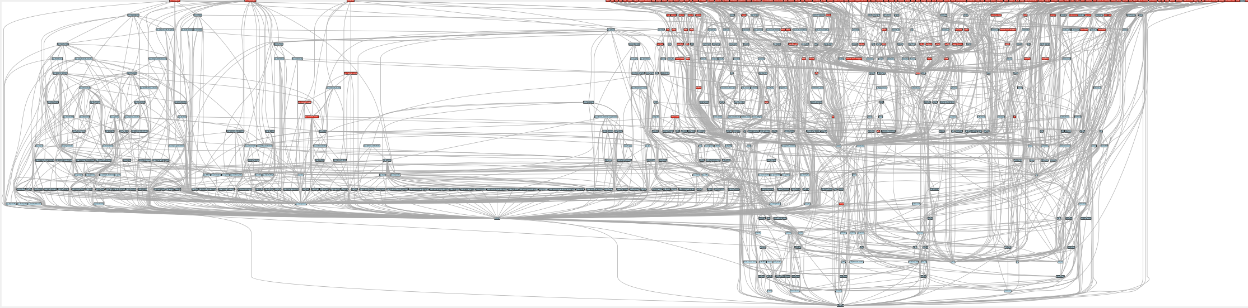
ECP’s E4S stack is even larger than these codes
  Red boxes are the packages in it (about 100)
  Blue boxes are what else you need to build it (about 600)
  It’s infeasible to build and integrate all of this manually

Slide 50
What does the Spack project look like?
E4S
AWS
LLNL stack
xSDK
Vis SDK
App
External Stacks
. . .
Spack Community 💁‍♂️ 💁🏾 💁 💁🏻‍♀️ 💁🏻 💁🏾‍♂️ 💁🏻‍♂️ 💁‍♀️ 💁🏼‍♂️ 💁🏾‍♀️ 💁🏼 💁🏽‍♀️ 💁🏽‍♂️ 💁🏽 💁🏼‍♀️ 💁🏼‍♂️
Infrastructure
Package Recipes
Core tool (CLI + Solver)

Slide 51


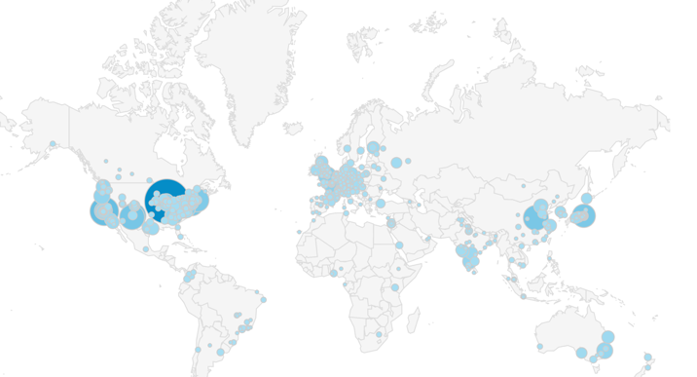


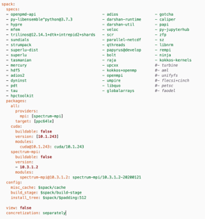

CI has made Spack builds much more reliable!
Spack Contributions
on GitHub
(over 1,000 contributors)
gitlab.spack.io
x86_64 and aarch64
pipelines in AWS
ppc64le, GPU pipelines at
U. Oregon
spack ci
Pipelines at LLNL
(Cray PE soon)
spack.yaml
configurations
(E4S, SDKs, AWS,
others)
GitLab CI builds (changed) packages
On every pull request
On every release branch
Do users really need to build from source?

Slide 52




With v0.18, Spack has a public binary cache
# latest v0.18.x release binaries
spack mirror add https://binaries.spack.io/releases/v0.18
# rolling release: bleeding edge binaries
spack mirror add https://binaries.spack.io/develop
Over 3,000 builds in the cache so far:
  Amazon Linux 2 x86_64_v4
  Amazon Linux 2 aarch64
  Amazon Linux 2 graviton2
  Ubuntu 18.04 x86_64
Do we trust binaries?

Slide 53




We aim to lower the burden of maintaining a binary distribution and make it easy to mix source builds with binaries.
Traditional
package manager
Portable (unoptimized)
x86_64 binaries
One software stack
upgraded over time
Recipe per
package configuration
(need rewrites for new systems)
Build farm
Optimized
Graviton2 binaries
Many
software stacks
Built for specific:
Systems
Compilers
OS’s
MPIs
etc.
Optimized
Skylake binaries
Spack
Parameterized recipe
per package
(Same recipe evolves for all targets)
Build farm / CI
Optimized
GPU binaries
Users/developers can also build directly from source

Slide 54
Our infrastructure enables us to sustainably manage a binary distribution
Untrusted S3 buckets
Public, signed binaries in
CloudFront distribution
Internal per-PR build caches
https://binaries.spack.io
github/pr-28468
github/pr-28469
develop
releases/v0.18
…
…
Contributors submit package changes
Maintainers review PRs
Rebuild and Sign
Iterate on builds in PR
Caches prevent unnecessary rebuilds
Verify PR build succeeded
Review package code
Protected signing runners
Ephemeral keys
Merge to develop
Published binaries built ONLY from approved code
Moves bulk of binary maintenance upstream, onto PRs
  Production binaries never reuse binaries from untrusted environment

Slide 55
Why should we care about this for our HPC codes?
LLNL ARES
Our codes use a lot of external software
  Most packages are external open source
  Many LLNL packages are also open source and developed in the open
We cannot replace all these OSS components with our own
  How do we vet all these components?
Key question: Who/what do you trust to validate the components?
  Current processes are not scalable and not automated!
30
12
71

Slide 56

We will continue scaling this infrastructure out!
We are doing 40k builds per week!
  There are lots of optimizations left to do on the build pipelines
  We think we can eventually scale to all 6,400 Spack packages
Goal: make source builds unnecessary for most users
  Source builds are optimized for x86_64_v4 (avx512), graviton, etc.
  Source builds will still be seamless – key for reproducibility
  Use spack develop to tweak (almost) any binary you can install
We will keep scaling OS, compiler, and arch support
  Current crop of compilers and OS’s is a bit old – expect a refresh
  Cray PE build coming soon!
Amazon Linux 2 builds work on AWS ParallelCluster NOW!
Build stats at
https://stats.e4s.io

Slide 57










A Notional Secure Pipeline
Binary
Packages
Open Source Contributions
Tarballs, other sources
Git commits
Verify
Scan
Build
Sign
Scan
Deploy
Container
Images
Spack has 6,500 packages,
with many updates per day.
Container
Build
Sign
Verify
We are working to establish a set of guidelines for supply chain integrity
  Labs are trending towards GitLab, Spack for HPC
  Standard container formats can help with scanning
  Standard Software Bill of Materials (SBOM) format could help sites
  cross-validate codes
Spack can help to standardize some of this.

Slide 58













Spack’s long-term strategy is based around broad adoption and collaboration
Not sustainable without a community
  Broad adoption incentivizes contributors
  Cloud resources and automation absolutely necessary
Preserves build knowledge in a cross-platform, reusable way
  Minimize rewriting recipes when porting
CI ensures builds continue to work as packages evolve
  Keep packages flexible but verify key configurations
Growing contributor base and automation are
the top priorities
  377 contributors to 0.18 release!
Spack
Community

Slide 59

The Spack community is growing rapidly
Spack simplifies HPC software for:
  Users
  Developers
  Cluster installations
  The largest HPC facilities
Spack is central to ECP’s software strategy
  Enable software reuse for developers and users
  Allow the facilities to consume the entire ECP stack
The roadmap is packed with new features:
  Building the ECP software distribution
  Better workflows for building containers
  Stacks for facilities
  Chains for rapid dev workflow
  Optimized binaries
  Better dependency resolution
Visit spack.io
github.com/spack/spack
@spackpm

Slide 60
E4S Summary
What E4S is not
What E4S is
A closed system taking contributions only from DOE software development teams.
A monolithic, take-it-or-leave-it software behemoth.
A commercial product.
A simple packaging of existing software.
Extensible, open architecture software ecosystem accepting contributions from US and international teams.
Framework for collaborative open-source product integration.
A full collection of compatible software capabilities and
A manifest of à la carte selectable software capabilities.
Vehicle for delivering high-quality reusable software products in collaboration with others.
The conduit for future leading edge HPC software targeting scalable next-generation computing platforms.
A hierarchical software framework to enhance (via SDKs) software interoperability and quality expectations.

Slide 61
Vision for E4S Now and in the Future
E4S has emerged as a new top-level component in the DOE HPC community, enabling fundamentally new relationships
E4S has similar potential for new interactions with other US agencies, US industry and international collaborators. NSF and UK are examples
The E4S portfolio can expand to include new domains (ML/AI), lower—level components (OS), and more.
E4S can provide better (increased quality), faster (timely delivery of leading-edge capabilities) and cheaper (assisting product teams)

Slide 62
E4S Hands-on

Slide 63
E4S on AWS: e4s-cl
https://e4s.io/tutorial Sign up for a host. For e.g., if you choose tut008.supercontainers.org:
https://tut008.supercontainers.org:8443/#e4s (pick the host)
login: tutorial
Password: HPCLinux12!
$ cat ~/README;
$ cd ~/Zoltan
$ singularity run ~/ecp.simg
Singularity>./clean.sh; ./compile.sh
Singularity> spack load trilinos@13.0.1 %gcc
Singularity> ldd ./Zoltan | grep mpi
Singularity> exit
# NOTE: exiting to the host is important for the next step of running the application!
$ cat run_e4s-cl_intelmpi.sh
$ cat ~/source.sh
$ ./run_e4s-cl_intelmpi.sh
$ cat run_e4s-cl_openmpi.sh
$ ./run_e4s-cl_openmpi.sh
$ ./run_e4s-cl_mvapich2.sh

Slide 64




Performance Research Laboratory, University of Oregon, Eugene
www.uoregon.edu

Slide 65
Thank you
https://www.exascaleproject.org
This research was supported by the Exascale Computing Project (17-SC-20-SC), a joint project of the U.S. Department of Energy’s Office of Science and National Nuclear Security Administration, responsible for delivering a capable exascale ecosystem, including software, applications, and hardware technology, to support the nation’s exascale computing imperative.
Thank you to all collaborators in the ECP and broader computational science communities. The work discussed in this presentation represents creative contributions of many people who are passionately working toward next-generation computational science.

Slide 66


